Slide 1
Treatment and Recovery
for Youth and Young Adults
With Substance Use Disorder (SUD)

Slide 2
Welcome and Introductions
Tara Moseley, MPAP
Policy Analyst
Innovative Policy Solutions

Slide 3

What’s the Point?
Why are we here?
To provide healthcare workers with the resources that will help recovering youth and young adults initiate and sustain long-term recovery in various settings by integrating programs geared for holistic recovery wellness, workforce preparedness, leadership development, and educational goal-setting.

Slide 4
Recovery Initiation
(ie. Treatment)
Comprehensive and multidimensional approaches must be utilized to help identify youth with a substance use disorder
SBIRT: Screening, brief intervention and referral to treatment.

Slide 5
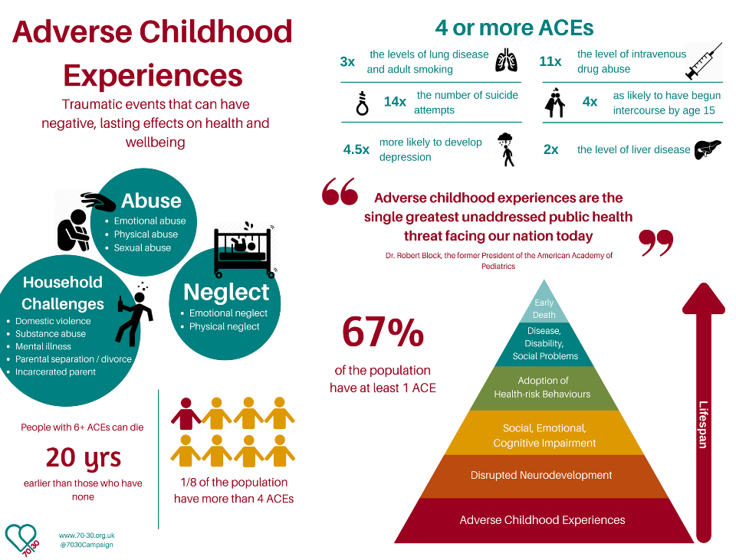

Slide 6
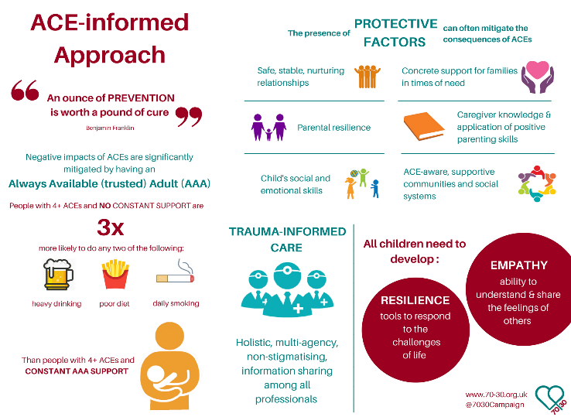
adverse childhood experiences (ACE)
  Training to identify and prevent ACE’s:
  https://vetoviolence.cdc.gov/apps/aces-training/#/#top

Slide 7
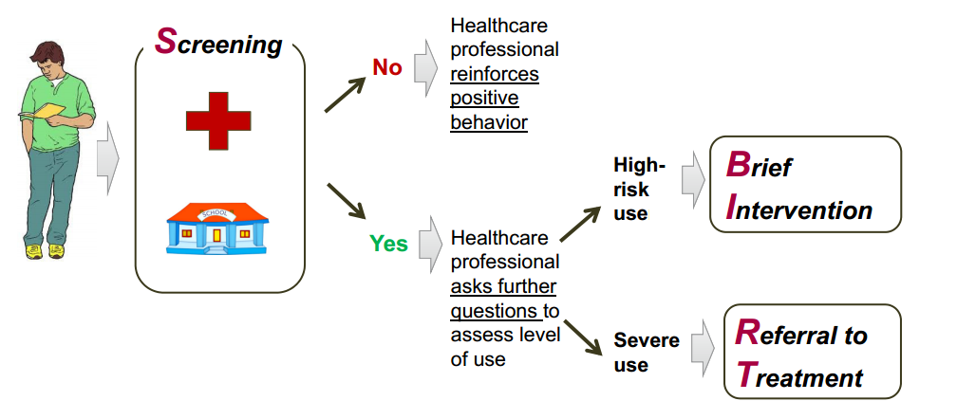
SBIRT
Screening, Brief Intervention, Referral to Treatment
https://www.umhs-adolescenthealth.org/wp-content/uploads/2019/04/sbirt_slides_updated.pdf

Slide 8
Recipe for Youth-centered treatment
Assessment and Treatment Matching
Comprehensive -Integrated Approach
Family Involvement in Treatment
Developmentally Appropriate Program
Engaging and Retaining Teens in Treatment
Qualified Staff
Gender and Cultural Competence
Evaluation of Treatment Outcome
Continuing Care

Slide 9
Young People in Recovery (YPR)

Slide 10
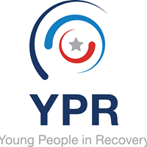

What is YPR?
National Team
Chapters in the Community
Our national leadership team creates and cultivates local community-led chapters through grassroots organizing and training. Chapters support young people in or seeking recovery by empowering them to obtain stable employment, secure suitable housing, and explore continuing education. Chapters also advocate on the local and state levels for better accessibility of these services and other effective recovery resources.

Slide 11

Where Do we start?
When working with young people, we have to start NOW! Young people need structure, but also need to have the ability to make decisions for themselves. How do we grab their attention? How do we mold, and support them?

Slide 12
Peer Support

Slide 13

Peer Support
What is peer support/provider?
A peer provider (e.g., certified peer specialist, peer support specialist, recovery coach) is a person who uses his or her lived experience of recovery from mental illness and/or addiction, plus skills learned in formal training, to deliver services in behavioral health settings to promote mind-body recovery and resiliency.
https://www.integration.samhsa.gov/workforce/team-members/peer-providers
Notes:
Research has shown that peer support facilitates recovery and reduces health care costs. Peers also provide assistance that promotes a sense of belonging within the community. The ability to contribute to and enjoy one’s community is key to recovery and well-being. Another critical component that peers provide is the development of self-efficacy through role modeling and assisting peers with ongoing recovery through mastery of experiences and finding meaning, purpose, and social connections in their lives.

Slide 14
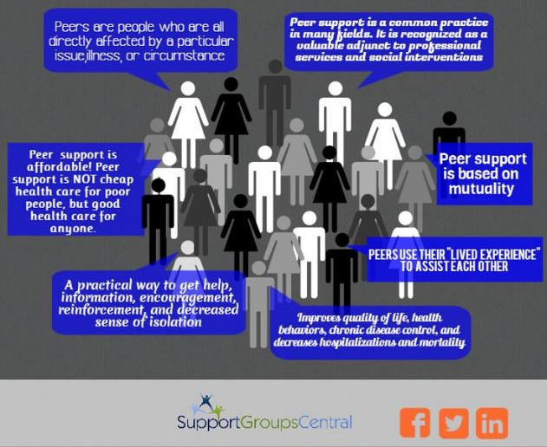
Peer Support

Slide 15
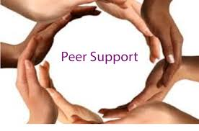
Peer Support
Used in many arenas:
Treatment
Prevention
Recovery Support services
Educational settings
Employment settings
Recovery Housing settings
…. And many others
Notes:
Treatment settings- Peers are used as role models to inspire hope and empowerment in recovery.
Prevention settings- Peers are used for a “hope” recognition- in a sense of “if they can do it, so can I”
Recovery Support settings- Peers are used in a network to enable community growth, development, and a sense of accountability.
Educational settings- Peers are used as mentors to transition to college lifestyle, study habits, positive prosocial activities
Employment settings- Peers are used as mentors to help direct employment boundaries, health, and self care.
Recovery Housing- Peers are used to be role models within transitional living… some may choose to have a “house manager” but when you have a trained peer to help oversee operations, and provide support, positive outcomes increase.

Slide 16
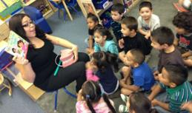

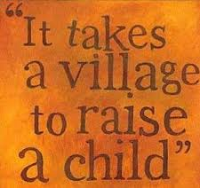


Youth and Peer Support
Notes:
Explain the different settings and how they are important to a childs development, especially for those who have SUD and/or cooccurring disorders.

Slide 17
Alternative Peer Groups

Slide 18
Alternative Peer Groups
An Alternative Peer Group (APG) is a community-based, family-centered, professionally staffed, positive peer support program that offers prosocial activities, counseling, and case-management for people who struggle with substance use or self-destructive behaviors. APGs are a much better fit for the adolescent who struggles with substance use and co-occurring disorders because the main focus is to offer and shape a new peer group that utilizes positive peer pressure to stay sober. In addition, APGs focus on making sobriety more fun than using by organizing and staffing sober social functions throughout the week, weekends, and summers.
For more information, see the film “Generation Found”
References:
http://generationfoundfilm.com/2016/12/05/alternative-peer-groups-powerful-tool-youth-recovery-across-nation/
Notes:
An Alternative Peer Group (APG) is a community-based, family-centered, professionally staffed, positive peer support program that offers prosocial activities, counseling, and case-management for people who struggle with substance use or self-destructive behaviors. APGs are a much better fit for the adolescent who struggles with substance use and co-occurring disorders because the main focus is to offer and shape a new peer group that utilizes positive peer pressure to stay sober. In addition, APGs focus on making sobriety more fun than using by organizing and staffing sober social functions throughout the week, weekends, and summers.
As a preface, APG models are not clinically based, but instead community-based recovery services that may have clinical support. This means that there are social events tied into an APG and family services. This is a key difference between an Intensive Outpatient Program (IOP) and an APG. APGs also welcome participation and communication and continued relationships with any therapist, psychiatrist or referring professional who is connected to the client prior to enrollment. Their approach starts with addiction is a disease
From Research- John Cates, Baylor University (NAADAC) (founder and CEO of Lifeway International, a residential treatment, IOP, PHP, APG and a recovery school under their umbrella of services)
This unique treatment model integrates the important peer connection with sound clinical practice through intervention, support, education, accountability and family involvement.
Requirements: – Completion of a substance abuse treatment program, a minimum of two months sobriety, parental permission if less than 18 years old, agreement to a behavioral contract stressing integrity and commitment to the program, especially attendance. – Parent participation is required. • Each APG is lead by a certified counselor

Slide 19
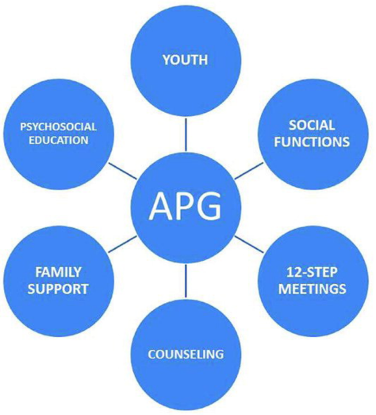
Alternative Peer Groups
Notes:
Success Factors • Accountability & consequences. • Fun – lot’s of group activities. • Kids get to be kids (with boundaries). • Parents “required” to attend and support recovery. • Parents achieve personal growth.
It is a very busy schedule, but most studies suggest that idle time and isolation in the first years of recovery are not helpful. There is an old saying, “My mind is like a bad neighborhood…not a place I should go alone very often.” APG Programs work very hard to help our clients and their families stay out of those neighborhoods and instead hang in neighborhoods of hope, growth, and healing.

Slide 20
Recovery High Schools

Slide 21

Recovery High Schools
Association of Recovery Schools (ARS) helps to develop, support, and inspire schools for optimum performance, empowering hope and access to every student in recovery.
Notes:
Recovery High Schools enable young person’s to have a supportive environment for those in recovery and/or co-occurring disorder’s and still have the same experience of a traditional high school.
Recovery High schools may have different therapeutic activities that will empower young people to develop the skills they need after graduating and preparing for college or the workforce.
Educational Outcomes from a Recovery High School in Houstin, TX (And APG attendance)
137 students enrolled (rolling admission) • 87% sobriety rate (students who stayed sober the entire school year) • 89% school attendance • 96% of seniors graduated • 28 graduates in 2012 • 96% of graduates attending college • 79% student retention (all grade levels)

Slide 22

Recovery High School’s
Although each school operates differently depending on available community resources and state standards, each recovery high school shares the following goals:
To educate all available and eligible students who are in recovery from substance use disorder or co-occurring disorders such as anxiety, depression, and attention deficit hyperactivity disorder
To meet state requirements for awarding a secondary school diploma
To support students in working a strong program of recovery
For more information:
https://recoveryschools.org/mission-and-vision/
Notes:
In short, recovery high schools are secondary schools designed specifically for students in recovery from substance use disorder or dependency.
The staff of recovery high schools most often includes administrative staff, teachers, substance abuse counselors, and mental health professionals that each play a critical role in supporting their students. Additionally, recovery schools provide support for families learning to how to live with, and provide support for, their teens entering into the recovery lifestyle.
High schools specifically designed for students recovering from a substance use disorder (substance abuse or dependence) have been emerging as a continuing care resource since 1987. This study of 17 schools provides the first systematic description of recovery school programs and their students. The most common school model is that of a program or affiliated school, embedded organizationally and physically with another school or set of alternative school programs. Although embedded, there are serious efforts to maintain physical separation of recovery school students from other students, using scheduling and physical barriers. Affiliation with public school systems is the case for most recovery schools, and seems to be a major factor in assuring fiscal and organizational feasibility.
Retrospective pretest to post-test analysis suggests significant reduction in substance use as well as in mental health symptoms among the students. Students were very positive in their assessment of the therapeutic value of the schools, but less enthusiastic regarding the educational programs. The school programs appear to successfully function as continuing care to reinforce and sustain the therapeutic benefits students gained from their treatment experiences.
For teenagers, school often sits at the heart of the relapse threat. Because they are minors, the majority of adolescents must return to their pretreatment neighborhoods and schools (in the case of residential treatment). Students treated as outpatients may never have a respite from using peers in their school and neighborhood. One study found that virtually all adolescents returning to their old school reported being offered drugs on their first day back in school (Spear & Skala, 1995). Students who attend schools with high overall use levels are particularly susceptible to use (Cleveland & Wiebe, 2003; Piper, Moberg, & King, 2000). For many adolescents, schools not only represent the environment of previous use and contact with pretreatment using friends, but the emotional turmoil involved with life transitions (Isakson & Jarvis, 1999). When young people leave residential treatment or while receiving outpatient treatment, if a private school is not financially possible, their options usually are limited to their former school or dropping out.
Vaillant (1988) finds that prosocial activities such as school assist the recovering person, and Resnick et al. (1997) believe “connectedness with school” is a general protective factor for adolescents. Under these premises, the first schools designed specifically to aid the newly sober teen opened in the late 1980s

Slide 23
Young People in Recovery

Slide 24
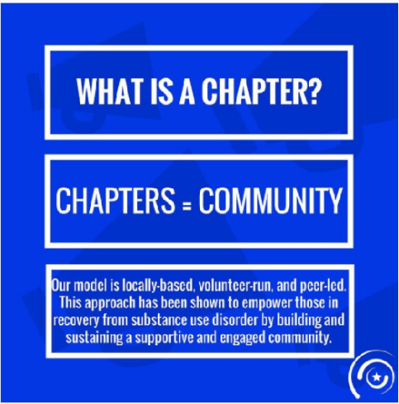
Young People in Recovery
Find a chapter near you:
www.youngpeopleinrecovery.org
Notes:
Young People in Recovery changes the world so all young people in or seeking recovery are given the opportunity to become empowered. Our national leadership team creates and cultivates local community-led chapters through grassroots organizing and training. Chapters support young people in or seeking recovery by empowering them to obtain stable employment, secure suitable housing, and explore continuing education. Chapters also advocate on the local and state levels for better accessibility of these services and other effective recovery resources.

Slide 25
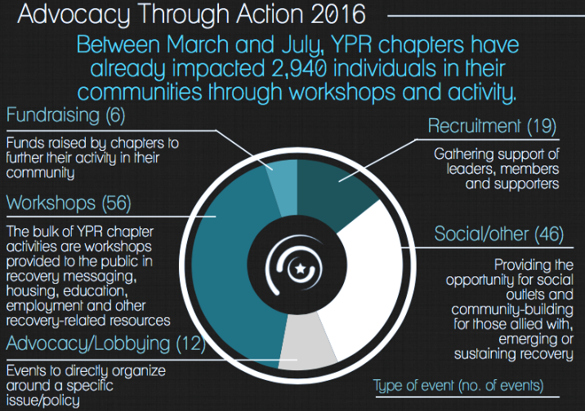
Young People in Recovery
Notes:
Go over each of the bullet points listed and what they are. Help to discuss the importance of reaching this population. From 2016 to 2020.

Slide 26
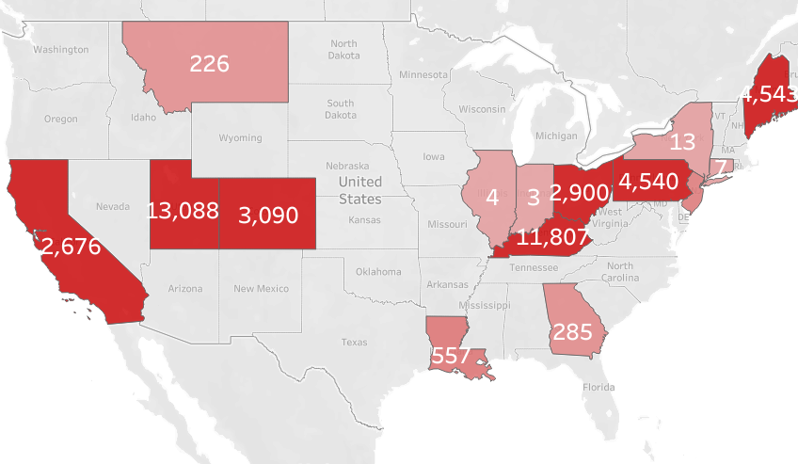
Young People in Recovery
Notes:
The number of interactions with Chapters has grown and has shown that Recovery support is not only important, but is needed from urban to rural areas.

Slide 27
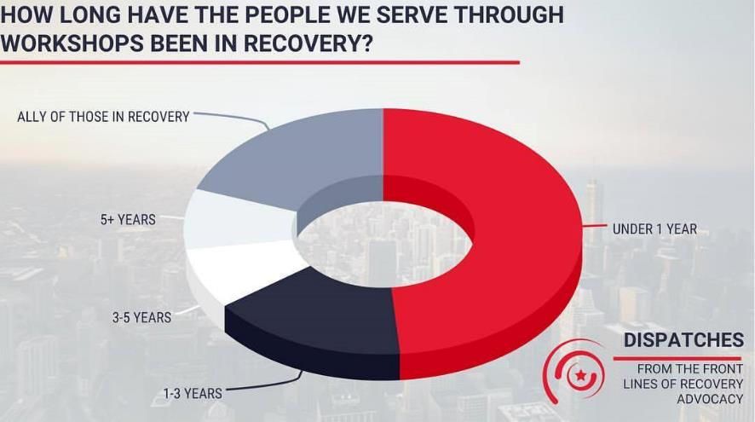
Young People in Recovery

Slide 28

Young People in Recovery
Education Workshop
YPR's Education Workshop: YPR's Education Workshop is free-of-charge and open to the public, targeting under-served and under-represented recovery populations. Whether it is a university, college, or trade school, YPR helps young people get in and stay in school. YPR’s workshop will help students through the application process, applying for financial aid, and developing an academic plan for success.
• Academic Mentoring Program: YPR will mentor new or returning students to help them reach their educational goals. This will include effective study habits, stress management, and recovery support.
Notes:
YPR's Education Workshop aims to help young people in or seeking recovery get in and stay in school. YPR's Academic Mentoring Program aims to help such individuals reach their educational goals through one-on-one academic support. YPR's Education Workshop and Academic Mentoring Program are free-of-charge and open to the public, and will target under-served and under- represented recovery populations (low-income and minority) in each Chapter's community.
Chapters will have flexibility to coordinate both the Education Workshop and Academic Mentoring
Program. For example, a Chapter may determine that conducting the Education Workshop seasonally
(i.e. during application time) is most effective. Further, a Chapter may determine that its Academic
Mentoring Program will consist of regular one-on-one meetings (e.g. weekly) in which mentors help
students in recovery develop an academic plan, and hold them accountable to such.
________________________________________________________________________________________________
One-fifth of all people who entered treatment have NOT finished their education. Further, drug use is more common among people who leave school early than among those who stay in school.
• Young people struggling with addiction are often conditioned to expect failure when it comes to
earning an education, and commonly live out this expectation through many self- destructive
decisions and choices made throughout their addiction, which ultimately results in an incomplete
education.
• Young people in recovery from addiction are often-times constrained by fear and anxiety,
which commonly prevents them from pursuing an education. This creates a problem because
education is a cornerstone of personal growth and development.
• Education improves employment opportunities, which in turn can lead to improvements in
income and living standards. Economic stability allows young people to reproduce their
recovery on a day-to-day basis.
• Pursuing an education will enable people to transfer skills learned in treatment to real life
situations, and to challenge themselves in a developmentally healthy manner.
• Pursuing an education enables young people in recovery to tap into their potential, rise above
adversity, challenge themselves, develop resilience and perseverance, and gain confidence.
Additionally, they will learn to replace negative beliefs about themselves with emerging ideas
and renewed ambitions that provide meaning and purpose to their lives.

Slide 29

Young People in Recovery
Employment Workshop
YPR’s Employment Workshop: The goal of the employment workshop is to help attendees become employable, teach them the requisite mindset to develop healthy work habits, and inform them of the laws that govern addiction in the workplace. The workshop consists of six parts, and is designed to be interactive.
Designed to be interactive in (6) portions:
Create resume
(2) Learn how to write a cover letter
(3) Interviewing tips
(4) On the job tips
(5) Expungement process
(6) Know your rights

Slide 30
YPR:
My Recovery is E.P.I.C. and the numbers behind Peer led, lifeskills

Slide 31
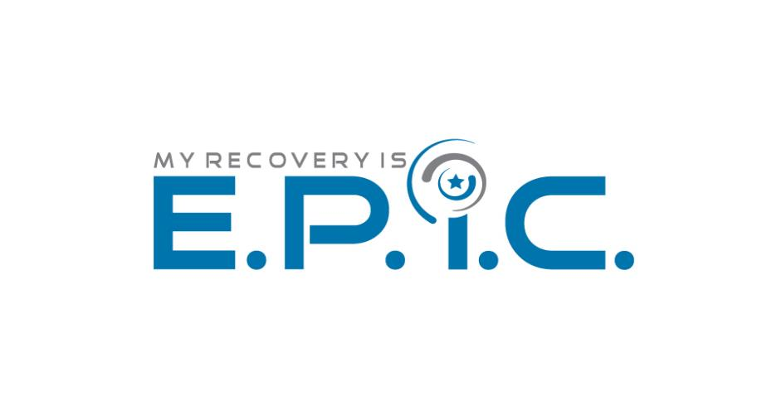
My Recovery is E.P.I.C.
My Recovery is E.P.I.C. is a comprehensive life-skills curriculum offered exclusively by Young People in Recovery that focuses on improving access to housing, education and employment. E.P.I.C. stands for:
E = Engaged
P = Peer-Driven
I = Integrated
C = Community
Notes:
. E.P.I.C. is informed by the four dimensions that SAMHSA has identified as being critical to a successful life in recovery: health, home, purpose and community. YPR and our partners have found that individuals who are more actively engaged in their life-planning are also more successful in their treatment and recovery process, and become more informed decision-makers overall.
By providing individuals with the tools they need to take action, the E.P.I.C. program creates more positive outcomes in traditional treatment settings. Now, individuals don’t have to wait for reintegration in their communities to receive the resources they need for upward mobility in their lives in recovery. From the start, their recovery can be E.P.I.C.

Slide 32

Comprehensive Life Skills
Employment:
Getting back to work is an important part of everyone’s recovery journey. However, it can be challenging in early recovery to know how to find the right job, what to say about your recovery, or even if working is the right fit. Preparing yourself with interview tips, identifying your skills, and learning what it is that you want to do in life are all important parts of the recovery journey.
Notes:
Employment enhances personal growth by increasing
financial responsibility
Discipline
Integrity
Patience
Tolerance
Also discusses self-sufficiency and that employment will help with the accomplishment of goals. It is important for the individual to feel empowered when looking for a job so this any mean to clean up any wreckage of the past by expungement if possible. If not, giving the person tools to discuss what happened, by describing what they are doing now. It is important for the person to take responsibility for their past, but not let it define then and keep them from finding stable employment. We also discuss knowing your rights as a person who has a substance use disorder, and how it is against the Americans Disabilities Act to discriminate against you with this diagnosis.
Next, there is discussion about cover letters, where to apply, where not to apply, and building resumes.

Slide 33

Comprehensive Life Skills
Education:
As you enter into the recovery process, there is no reason that you should have to choose between an education and your recovery. Pursuing and attaining your higher education goals is empowering, and will provide new skill sets that allow you to have success personally and professionally.
Notes:
That being said, continuing education should be approached with care and with a plan so that your recovery is protected. By identifying your educational goals, you will be able to set a plan in place to protect your recovery and finish your education!
Discussion about Recovery Oriented Education: means that the system is set up to serve people who are in recovery. This means looking at education as a part of our recovery process which is connected to all of the other parts.
Education increases personal capital- personal capital helps to increase our personal goals. This leads to the discussion of recovery capital and is what leads to the discussion of what recovery capital is- (ie levels of physical, social, mental, and spiritual wellness) All of which are subtypes of Recovery capital which helps us (Healthcare workers/peer support/therapist) to identify potential areas of growth or needs.
Education is not just about the physicalness of going to a school. It is also about connectedness, socialization, cultural competency, and exposure to other views etc. Highlighting the fact that this is about community which again helps to direct the young person to reinforce themselves with positive role models and become educated about themselves and relationships. Obviously the more they learn the better chance of a successful outcome since they will be more insulated from problematic environmental factors (besides the obvious in a college setting).
This module lays out steps to proceed from GED, Community college, Technical/Trade School, bachelor degrees, and Graduate degrees.
Then presenting questions about: (give examples of each)
time-management, balancing
Setting Goals
Financial Goals
Boundaries
Planning
Balancing

Slide 34

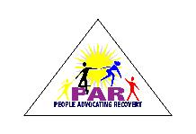



Comprehensive Life Skills
Recovery Messaging:
Recovery messaging incorporates language that you can use to talk about recovery from addiction to alcohol and other substances, process of addiction, or any quality of life concern.
Notes:
This message is a result of in-depth public opinion research with members of the recovery community, including young people in recovery, and the general public. We encourage you to use this “messaging” or language whenever you’re speaking – as a person in recovery, a family member, or friend.
(Put plug in for The Anonymous People on Wednesday night)
Many advocacy organizations use recovery language. However, we still struggle to use this language in our everyday life. Although we keep this language fresh when we are in front of reporters, we do not use it in front of new commers in our pathways of recovery. WE really do them an injustice and a disservice when we use stigmatizing language to describe ourselves, and then get mad at people for doing this on the internet and on the TV. Misinformation spreads like wildfire before any positive accolade ever will, we can talk to past Ms. United States, Tara Conner about that. What this module does is to help youth and young adults prepare for those tough questions about what “happened” to them and to better explain it in a way that will give the listener a clear message. This language has been proven to be especially effective with potential employers, and those in positions of management or authority.

Slide 35

Comprehensive Life Skills
Finance:
Knowing how to pay bills is one thing, but knowing how to set a budget and save money is a completely different experience.
Notes:
We are not only learning to become well-rounded individuals, productive members of our community, but also learning how to be independent. Independence comes with responsibility. Financial freedom may look differently for each individual, but knowing how to master a budget plan and prepare for those “rainy days” will enable independence and keep stress at a minimum.
With this module we look at creating a budget on real life terms. If the participants do not already have the knowledge of what will be expected of them when they are living independently, then this will give them their first clue. They will draft a budget for themselves and also look at what they expect their income to be. This helps for them to put things into perspective and also to set some healthy boundaries for themselves.
The module talks about positive spending habits and negative ones, also some positive ways to reward yourself for staying on track. Rewards are important and recognizing the good things, esp[ecially when we are in a system to always recognize the bad.

Slide 36
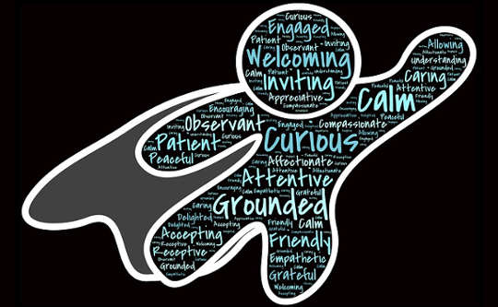
Comprehensive Life Skills
Empowerment:
While we are working to better ourselves through our recovery process, we begin to see the possibilities of life.
Notes:
Once we have felt that we can and will be successful the work is not over. We continue to grow and develop as individuals, and as professionals. This workshop will demonstrate a means to utilize our recovery as an empowerment tool in our communities. After all, we are changing everything in our life to become healthy whole individuals, and we should share our experience to empower others and ourselves.
When you think of the word empowerment what do you think about?
Family
Life
Balance
mindfulness
Discussions about:
Empowered recovery
Working with mentors
Own your decisions
Don’t be ashamed of you past substance use
Be proud of your recovery
recovery advocacy

Slide 37
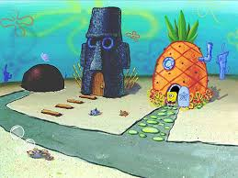
Comprehensive Life Skills
Recovery Housing:
Recovery residences are a part of the continuum of care in your new recovery journey that will surround you with like-minded individuals, clinical services, and a chance to integrate back into everyday life.
Notes:
What works for one, may not work for all.
There are several types, or levels, of recovery residences – all of which have different services and resources. Finding the right recovery residences for you, not only personally but clinically, is an important part of your recovery journey. This module covers all of the types of recovery housing that was laid out by the National Alliance for Recovery Residences.
Our hope is to equip the individual with enough information about potential residences to help them to make better decisions about what to do when stepping out from a residential treatment provider. Not only by telling them what levels of care that are available but to also provide them with the best ways to help them to cope with living life independently. We know that making big changes can really impact the individual to a point of them becoming hyper aroused and it is either fight or flight.
This also discusses preventive factors about roommates and family. Getting the youth or young adult to think about these situations and their complexities will get them to think more about what is healthy and unhealthy environments for themselves and for their recovery to blossom.

Slide 38


Comprehensive Life Skills
Leadership:
We all play a role of Leadership in our own lives. Leaders are those individuals that take responsibility for achievements and setbacks.
Notes:
Learning how to be a leader is another tool in the tool box. You set an example as a role model for those who are seeking recovery, and also having those that you see as a role model or an example of what you want for your own life. Learning how to use those experiences you have lived and learned to be successful will help others and yourself become leaders in their own life.
This module helps the individual to think more about the consequences of their actions and decisions. Which will enable them to think more about weighing the options more and thinking critically about taking action. It forces them to ask themselves whether they look up to someone, who they look up to, and why? Then moving to if someone looks up to them and they don’t even know it- how they would react knowing?
Leadership can impact:
Finding a purpose
Community trust
Fulfillment
Discipline
Potential
It discusses the many different forms of leadership and also that leaders need support just as their team.
Then it goes over the dangers of ego and the potential impacts of this getting out of control. It is good to have confidence, but not at the expense of others.

Slide 39

Comprehensive Life Skills
Social Inclusion Model:
Peers to support those in early recovery by creating a space for young people to have fun. They are a conduit for other volunteers to interface during those groups with your clients (or persons in recovery).
Notes:
Young People in Recovery (YPR), through identification of best practices, is implementing in your community and YPR Chapter to support the work you are doing! We have developed a comprehensive process and support system by which all YPR chapters across the nation are built, launched, and supported as they begin making your community “Recovery Ready”!
Having a YPR chapter in your area will be the catalyst to you’re my Recovery is EPIC program’s success! We hope that you get involved and learn more about our chapter process. For now, we will focus on how the chapter and the chapter members will be assisting your sites efforts on EPIC!
The YPR Chapter Leader of your area will be become your greatest ally and supporter! We will ensure your contacts are frequent and meaningful in order to provide the best outcomes possible. Your role as an EPIC Facilitator will to host the groups in your site facility. The role of the YPR Chapter Lead will be to support those groups and to you a conduit for chapter member volunteers to interface during those groups with your clients (or persons in recovery). We are excited about this integration process as it has proven a method for developing lasting relationships which can greatly impact the success of achieving sustainable, long-term recovery.
Your EPIC Program Implementation Trainer will walk you through the process of getting the chapter started and explain more about the process. The most important part, we are HERE TO HELP!

Slide 40
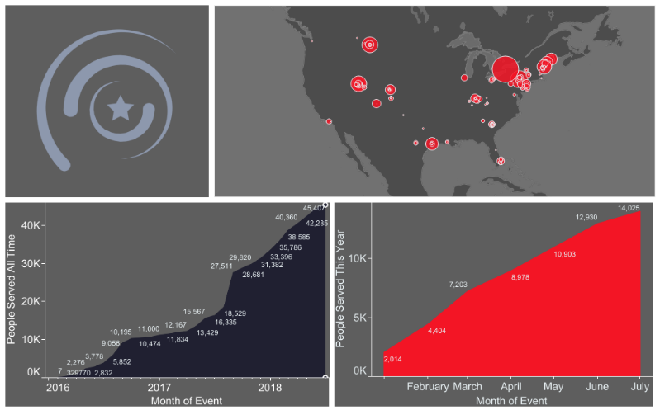
My Recovery is E.P.I.C.!
Notes:
Chapter Data from all Chapters not just one related to EPIC.
Describe the workshops, chapter events, recovery advocacy events, fundraising, prosocial activities, public speaking, and volunteering.

Slide 41
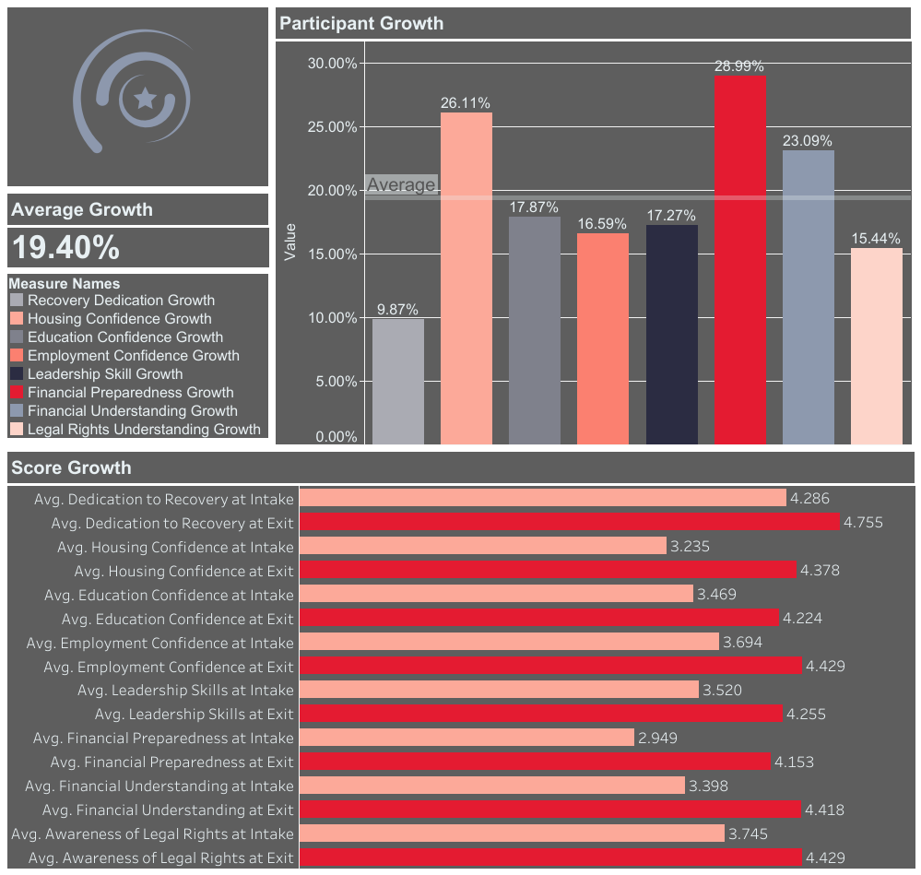
My Recovery is E.P.I.C.!
Notes:
All over averages of individuals from entrance to exit interviews and in what areas there was growth.
ARC scores: Assessment of Recovery Capital 50 questions, 5 point Likert scales, 10 areas of focus (domains)
Only 8 are listed since those are related to the program.

Slide 42
My Recovery is E.P.I.C.!
Notes:
We use a 5 point Likert scale which means that 5 is the best of the best. These are represented as averages for all participants Intake and exit interviews before and after the completion of the program.

Slide 43
Collegiate Recovery Support

Slide 44



Collegiate Recovery Services
A collegiate recovery program (CRP) is a College or University-provided, supportive environment within the campus culture that reinforces the decision to engage in a lifestyle of recovery from substance use. It is designed to provide an educational opportunity alongside recovery support to ensure that students do not have to sacrifice one for the other.
Notes:
The collegiate recovery movement developed to support the treatment and recovery of students within a heavy drinking culture where 6% of the population (or 474,000 students) meets diagnostic criteria for alcohol dependency (Knight, 2002). In coordination with primary and secondary prevention programs, tertiary supports such as collegiate recovery communities (CRCs) and collegiate recovery programs (CRPs) respond to the need to support the recovering college-age student and to increase access to treatment for the student still in active addiction (Smock et al., 2011). Parallel to this, a movement to provide support services for high school students has emerged (White and Finch, 2006).
The recovering schools movement responded to the very specific needs of a population seeking recovery within (what Cleveland et al. 2004 call) abstinence-hostile environments ” so called because, in addition to direct pressures to use alcohol and drugs heavily, the saturation of drugs and alcohol in all manner of activities creates the constant expectation that one needs to drink and use drugs to participate fully in college life.
To meet the needs of this growing population of recovering young adults as they pursue their educations, several colleges and universities have developed collegiate recovery communities to help young adults in recovery maintain their abstinence while pursuing their educations. The primary goal of these communities is to provide a safe haven for young adult students who are struggling to maintain their hard-won abstinence while surrounded by the frequent and heavy drinking that defines the social contexts of American college campuses (Schulenberg & Maggs, 2002). It is hard to imagine a situation that could be more hostile to the abstinence of young adults who are trying to maintain their recovery from substance abuse (Wiebe, Cleveland, & Harris, 2010, p. 6).
Although there are fewer CRPs and CRCs than higher education institutions, preliminary data suggest that they effectively promote recovery, prevent relapse, and improve educational outcomes for the individuals participating in them (Cleveland, Harris, Baker, Herbert, & Dean, 2007, in Smock et al., 2011).

Slide 45
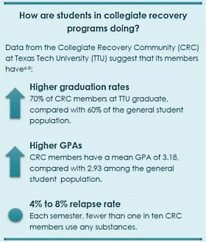
Collegiate Recovery Services
Support
Success
Notes:
Figure shows the statistics at Texas Tech University CRC.

Slide 46
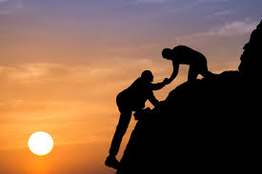
CRP’s vs CRC’s
Collegiate Recovery Programs
Collegiate Recovery Communities
For more information: https://collegiaterecovery.org
Notes:
Collegiate Recovery Programs (CRPs) and Collegiate Recovery Communities (CRCs) are terms that are often used interchangeably to describe an institutionally sanctioned and supported program for students in recovery from addiction seeking a degree in higher education. The goal of a CRP or CRC is generally to offer the chance for students in recovery from addiction to experience the opportunities that higher education offers both in the college environment, and after by providing support, preventing a return to use, and promoting academic performance. Research informs us that the most essential elements to a successful CRP/CRC are:
University- dedicated staff person
A physical dedicated space on University campus
Embrace abstinence-based recovery
Housed within Institutions of Higher Education that confers acdemic degrees
Program provides recovery protection services and recovery capital resources
Program must include a community of students who offer each other peer support
Non-profit entities
However, as this is a relatively new field and programs are starting all the time, individual CRPs may likely vary on key dimensions.
While the terms CRP and CRC are often used interchangeably, some programs use them in slightly different manners. There may be differences in the level and involvement of the university and the roles played by the staff, they may refer to one as the program and the other as the actual community of students within the program. When inquiring about a program at a specific institution, be sure to clarify what they mean when they use a specific term.
Activities:
Most CRPs offer space for the community to come together to build relationships and join in fellowship. Some CRPs provide academic courses, retreats, leadership workshops, gender-specific events, health and wellness activities, recovery conferences, etc. Almost all CRPs strive to provide space on their campus for different 12 step fellowships and recovery support groups. Some are located on campus in shared space, a classroom or inside of the CRP. These meetings are peer organized and led by the students. CRP professionals can coordinate community-building projects.
Describe differences and similarities of each.
UK has a CRP
UofL has an upcoming CRC
Morehead is working on CRP
We are currently working to develop CRC’s and YPR Chapters on Campuses at different Universities in Kentucky:
Eastern Kentucky University
Lyndsey Wilson College
Union –Knox County KY
University of Pikeville
Northern Kentucky University
Maysville Community and Technical College
Morehead University
Thomas More (?)

Slide 47
Recovery Community Centers

Slide 48
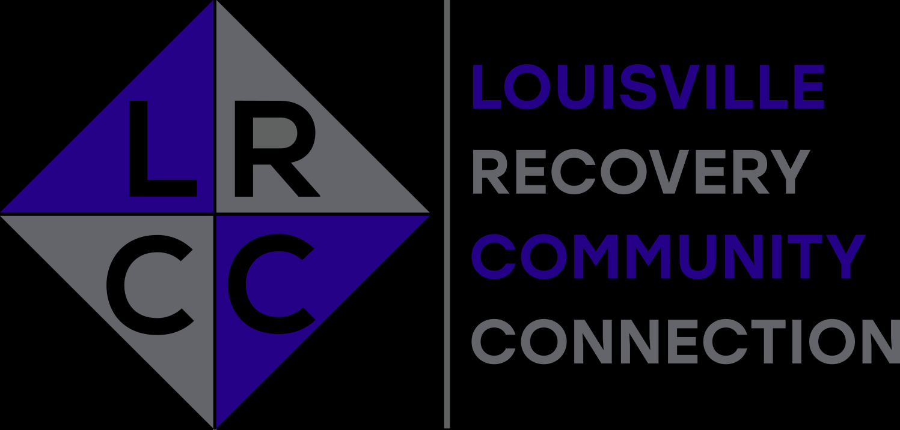

Recovery Community Centers
Recovery Community Centers (RCC) are a resource for education, information, support and socialization for those in recovery and their family and friends. It is meant to authenticate that recovery from the disease of addiction is possible. Our Recovery Community Centers are the hubs for all of our services.
Notes:
The basis of services and programming available through the Recovery Centers are Peer Recovery Support Services (PRSS). These are non-clinical services focusing on removing barriers and providing invaluable resources to those who are seeking to achieve and maintain long- term recovery. Peer Driven and Peer Delivered Support Services are fueled by the energy of volunteers who seek to share their experience and knowledge with others. The support offered is not meant to replace treatment or 12 Step support. PRSS acknowledge multiple pathways to Recovery.
A Recovery Community Center promotes improving quality of life, preventing relapse and sustaining recovery. It is not a clubhouse. It is a place where life’s challenges are faced with solutions and guidance. It is a place where skills are shared and learned. It is a place where isolation becomes inclusion and strangers become friends.
The development and provision of peer-driven support services are a priority for PRO-ACT. We provide a growing matrix of peer-to-peer support services which has led to the opening of three Recovery Community Centers, now the hub for all our services. Each center is unique in that it provides services, specific to their area, identified to be important and necessary to support the needs of those wishing to access and sustain long term recovery.

Slide 49
Recovery Community Centers
TAYLRD Drop-In Centers:
Ashland • Louisville • Morehead • Taylorsville
Transition-age youth in Kentucky will be able to easily access a seamless array of high-quality, culturally and developmentally appropriate, youth-driven supports and services that will help them achieve their goals and reach adulthood successfully.
For more information: http://www.taylrd.org/drop_in.php
Notes:
Transition Age Youth Launching Realized Dreams (TAYLRD) aims to positively impact the lives of Kentucky’s 16-25 year olds who have, or are at-risk of developing, behavioral health challenges by improving access to high-quality, culturally and developmentally appropriate supports and services across the state.
Currently, they have resources for Mental Health services and are expanding those services to SUD. This is a great place to enhance support services for youth in an engaging environment.
Our spaces are co-designed with young people to be fun, comfortable, and safe; that is why they offer so many cool things!
Free Snacks
Computer Lab
Pool Table
Video Games
Goal Setting
Peer Support
Case Management
Employment/Education Services
Connections to Resources
And More!!!

Slide 50

Recovery Community Centers
Louisville Recovery Community Connection
At the Louisville Recovery Community Connection (LRCC) we engage our community and build meaningful relationships by supporting individuals, families, and loved ones impacted by addiction. We aid individuals in accessing and sustaining long-term recovery
Peer Support
Recovery Coaching
Job readiness
Access to equitable housing
Access to educational institutions

Slide 51
Recovery Continuum

Slide 52
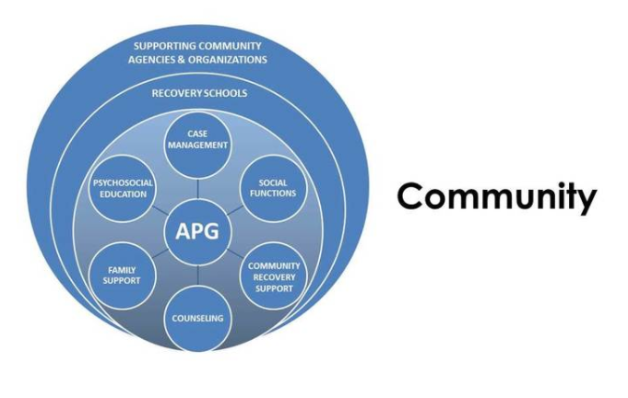
On-going Support Services
Notes:
Creating a community from the APG model

Slide 53
Community Support Services
Recovery Continuum of Care
Recovery High Schools
APG’s
Peer Support
CRC/CRP
YPR/My Recovery is EPIC!
Recovery Community Centers
Notes:
Following all around the Hexagon, we can see how there is a step between each type of support. We use step down models in treatment plans. We should use a similar method for recovery supports. Discuss how each age population needs specific supports and how the services are tailored for those populations.

Slide 54
Social Inclusion
Building a community for young people = connectedness = long term recovery
Notes:
Whether it is a peer or mentor developing a one-on-one relationship in which a peer leader with recovery experience encourages, motivates, and supports a peer in recovery
Peer recovery resource connecting—connecting the peer with professional and nonprofessional services and resources available in the community
Recovery group facilitation—facilitating or leading recovery-oriented group activities, including support groups and educational activities
Building community—helping peers make new friends and build healthy social networks through emotional, instrumental, informational, and affiliation types of peer support

Slide 55
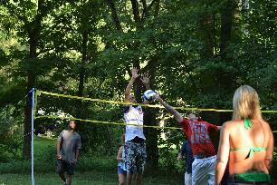
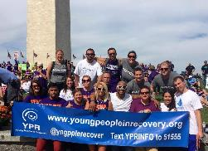
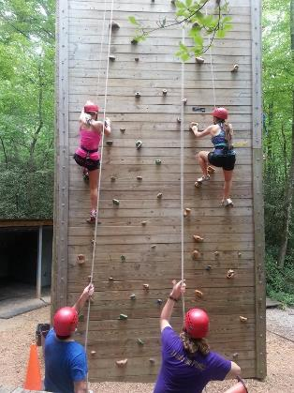
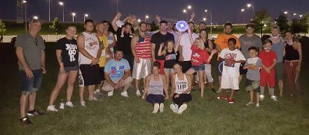
Creating Spaces for Social Support
Notes:
Each of the photos represents an opportunity, and its potential for us to reach youth and reach others. This is only the first step, pro-social event brings people to the table. This is a means of grabbing attention, especially when it comes to youth… the potential of empowerment for success becomes greater when we can get them to come to events and get involved… it starts here and leads to

Slide 56


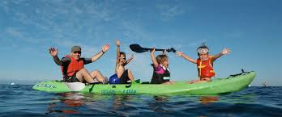
More about Social Inclusion…
…And it is all about the “FUN”!
For youth, it is imperative that there is social support. Creating those spaces, in healthy environments for them to be themselves and to have peers and role models that will show them how to develop, grow, and mature in their recovery.
Notes:
The resources we listed are positive environments that will nurture recovery in youth to grow and develop. We know it is hard to get the attention of youth, programs can be never-ending tiredness. That is not what drives them, they need and crave friendships, fun, and something stimulating. Creating opportunities for them to grow by hosting team building activities where they wont even know they are learning from it is a great way to get positive attention and to reinforce a healthy environment.
Some activities that are stimulating:
Yoga
Painting
Small team projects (like building, cooking, etc)
Playing sports

Slide 57
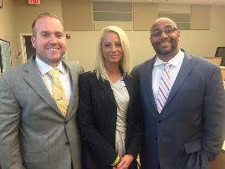
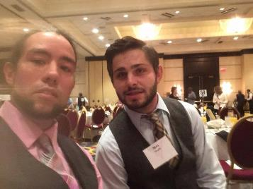
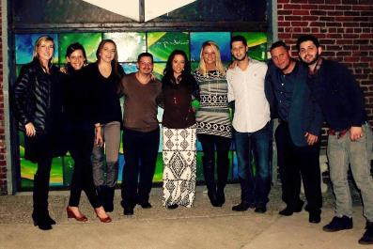
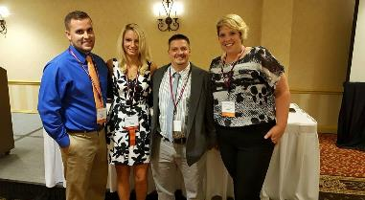
Social Development…
... Leads to Professional development!
Notes:
We provide a space where youth are able to grow and develop into professionals by training them with leadership activities and roles. By giving them the space to do this, they will create a strong foundation for their recovery, and enhance & elevate their growth as young people on their path to adulthood. Some of those activities can include:
Messaging training for speeches
Team building activities
Leadership positions
Volunteering in the community

Slide 58
Questions/comments

