Slide 1
OUD and MAT
A Patient’s Perspective
Steven Samra
Elizabeth Bryson
Eddie Donnally
December 10, 2019
Notes:
How has MAT been beneficial to their quality of life? What are the major healthcare and community pillars that have been most helpful to the individuals? What are the biggest challenges associated with MAT?

Slide 2
Working with communities to address the opioid crisis
SAMHSA’s State Targeted Response Technical Assistance (STR-TA) grant created the Opioid Response Network to assist STR grantees, individuals and other organizations by providing the resources and technical assistance they need locally to address the opioid crisis .
Technical assistance is available to support the evidence-based prevention, treatment, and recovery of opioid use disorders.

Slide 3
Working with communities to address the opioid crisis
The Opioid Response Network (ORN) provides local, experienced consultants in prevention, treatment and recovery to communities and organizations to help address this opioid crisis.
The ORN accepts requests for education and training.
Each state/territory has a designated team, led by a regional Technology Transfer Specialist (TTS), who is an expert in implementing evidence-based practices.

Slide 4

Overall Mission
To provide training and technical assistance via local experts to enhance prevention, treatment (especially medication-assisted treatment like buprenorphine, naltrexone, and methadone), and recovery efforts across the country addressing state and local - specific needs.

Slide 5
Substance Abuse and Mental Health
Services Administration (SAMHSA)
Funding for this initiative was made possible (in part) by grant no. 6H79TI080816 from SAMHSA. The views expressed in written conference materials or publications and by speakers and moderators do not necessarily reflect the official policies of the Department of Health and Human Services; nor does mention of trade names, commercial practices, or organizations imply endorsement by the U.S. Government.

Slide 6
Opioid Use Disorder

Slide 7
Learning Objectives
Comprehend and describe
Comprehend and describe medication assisted treatment
Explore
Explore various healthcare and community supports that are critical pieces to a successful MAT program
Identify
Identify potential barriers to MAT and discuss solutions to these barriers

Slide 8
Opioid Use Disorder
Primary chronic brain disorder characterized by compulsive substance-related behaviors/use, despite harmful consequences.
Involves cycles of remission and recurrence.
Biopsychosocial underpinnings
  40-60% genetic contribution
  Environmental risk factors
    Trauma - ACEs

Slide 9
Characteristics of having a SUD/OUD
  Problems with mood, cognition, and decision-making
  Abnormal reactivity to stress and environmental cues
  Overwhelming cravings
  Impaired insight and the impaired ability for care for oneself
  Increased risk of injury and/or infection - highest mortality of all psychiatric disorders.

Slide 10
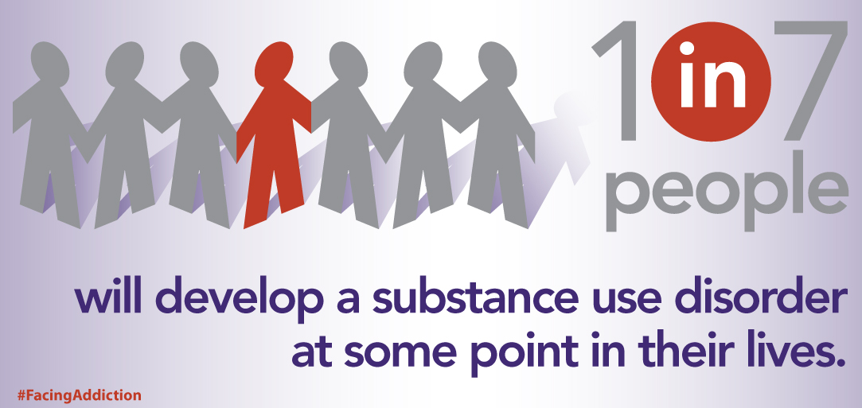
How common are SUDs?

Slide 11
Opioids - Sobering statistics
U.S. makes up 5% of the world’s population and consumes ~80% of world’s Rx opioids.
Roughly 21%-29% of patients prescribed opioids for chronic pain misuse them.
Between 8%-12% develop an opioid use disorder.
An estimated 4%-6% who misuse prescription opioids transition to heroin.
About 80% of people who use heroin first misused prescription opioids.
2017 data estimate 130+ people died each day in the U.S. from opioid related overdoses.

Slide 12
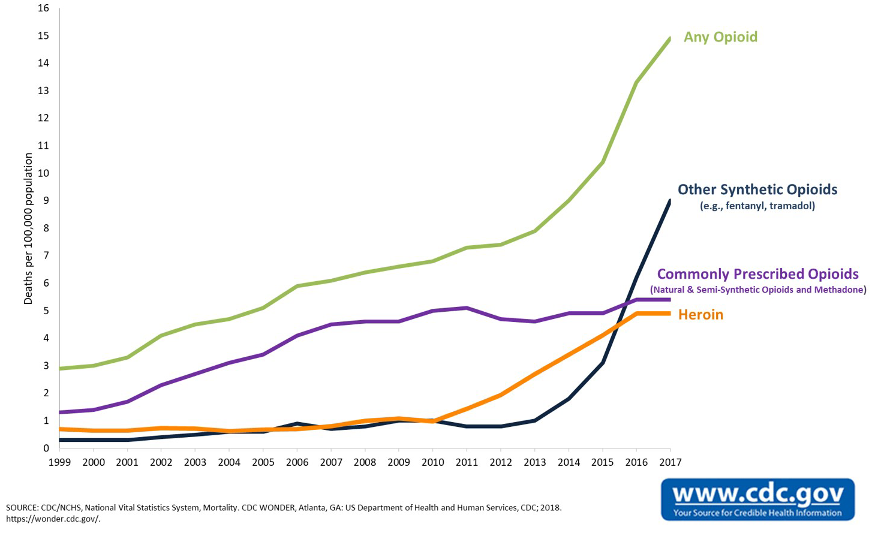
Opioid Death Rates: U.S.

Slide 13
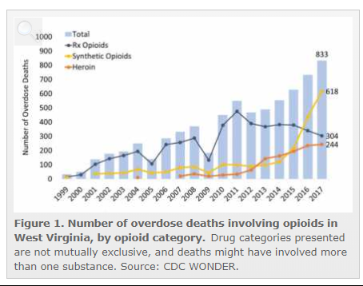
Opioid Death Rates: West Virginia
https://www.drugabuse.gov/opioid-summaries-by-state/west-virginia-opioid-summary

Slide 14
Medication Assisted Treatment (MAT)

Slide 15
Past approach to treatment
Based on the idea that substance use disorder is an acute and curable condition
  Abstinence was the only goal
  Priority was to remove the individual from access to the offending drug
  Services were time-limited
  3-5 day detoxification
  28-day residential programs

Slide 16
Past approach to treatment results
Withdrawal management by itself is no longer an acceptable form of treatment
→ Up to 90-93% return to substance use
Counseling alone has a high rate of relapse
  → Up to 60-90% return to substance use

Slide 17

Today’s Approach to Treatment
Evidence-based medicine:
FDA-approved Medication Assisted Treatment (MAT)
Counseling and/or behavioral therapy
Peer Support
Other supportive services
Notes:
Addiction can also be characterized as a disease of Brain Reward and Stress, Motivation Memory and Related Circuitry

Slide 18
Today’s Approach to Treatment
Most effective treatment for OUD involves a combination of several approaches:
  Medication for Addiction Treatment (MAT) involves use of medications in combination with intervention to increase adherence to medications
  Psychosocial/behavioral approach focused on helping patients develop skills necessary to maintain recovery
  Self Help/Mutual Help support groups form social network supportive of recovery
  Recovery-oriented activities help patients develop satisfying lives

Slide 19
Today’s Approach to Treatment
Harm reduction
Meeting the individual where they are at
  Precontemplation, Contemplation, Preparation, Action, Maintenance, Relapse
Motivational Interviewing
Peer Support
Continuum of ongoing care
Notes:
“Motivational interviewing is a directive, client-centered counseling style for eliciting behavior change by
helping clients to explore and resolve ambivalence. Although motivational interviewing does, in one sense, seek to "confront" clients with reality, this method
differs substantially from more aggressive styles of confrontation. More specifically, we would regard
motivational interviewing as not being offered when a therapist does the following:
• argues that the person has a problem and needs to change
• offers direct advice or prescribes solutions to the problem without the person's permission, or without
actively encouraging the person to make his or her own choices
• uses an authoritative/expert stance, leaving the client in a passive role
• does most of the talking, or functions as a unidirectional information delivery system
• imposes a diagnostic label
• behaves in a punitive or coercive manner

Slide 20
Today’s Approach to Treatment
Services are designed to:
Enable the Provider and the Patient to work together to make an Individualized Plan
Address associated physical, mental health, and/or psychosocial problems
Restore the patient to maximum functional capacity
Notes:
Addiction can also be characterized as a disease of Brain Reward and Stress, Motivation Memory and Related Circuitry

Slide 21
Goals of MAT
  Discontinue yo-yo effect of intoxication and withdrawal and restore normal brain function
  Restore the ability to have normal emotional responses and decision-making capacities
  Reduce high-risk behaviors
  Decrease reactivity to stress and drug related cues
  Block the reinforcing effects of illicit opioids
  Facilitate patient engagement in therapy and recovery-oriented activities
Notes:
Look over this slide

Slide 22
MAT Medications
Methadone – Full mu-opioid agonist
Buprenorphine – Partial receptor agonist
XR-Naltrexone – Antagonist of mu-opioid receptors

Slide 23
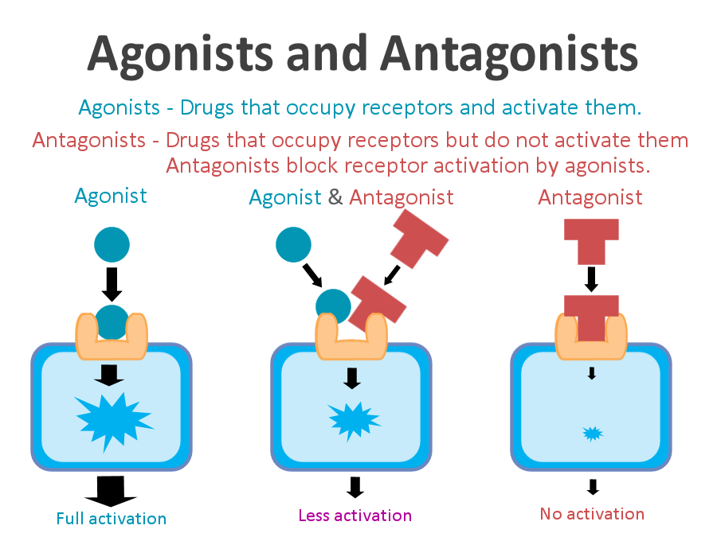
MAT Medications
https://psychonautwiki.org/wiki/Agonist

Slide 24
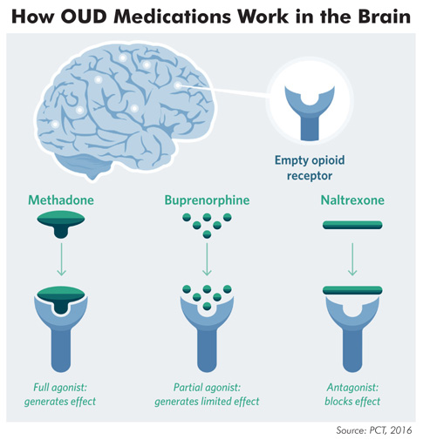
MAT Medications
http://www.practicenotes.org/v23n2/MAT.htm

Slide 25
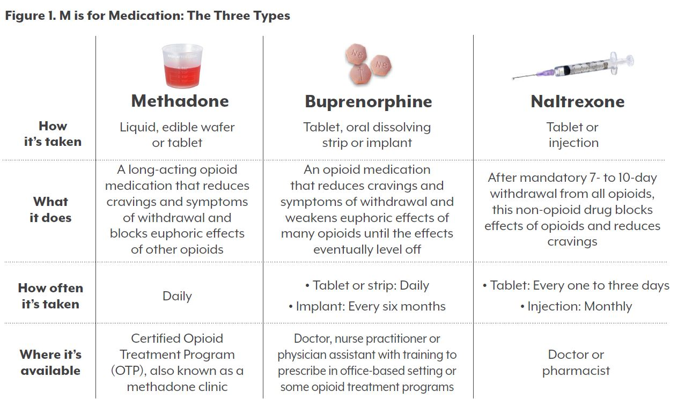
MAT Medications
https://www.coloradohealthinstitute.org/research/providing-medication-assisted-treatment-colorado

Slide 26
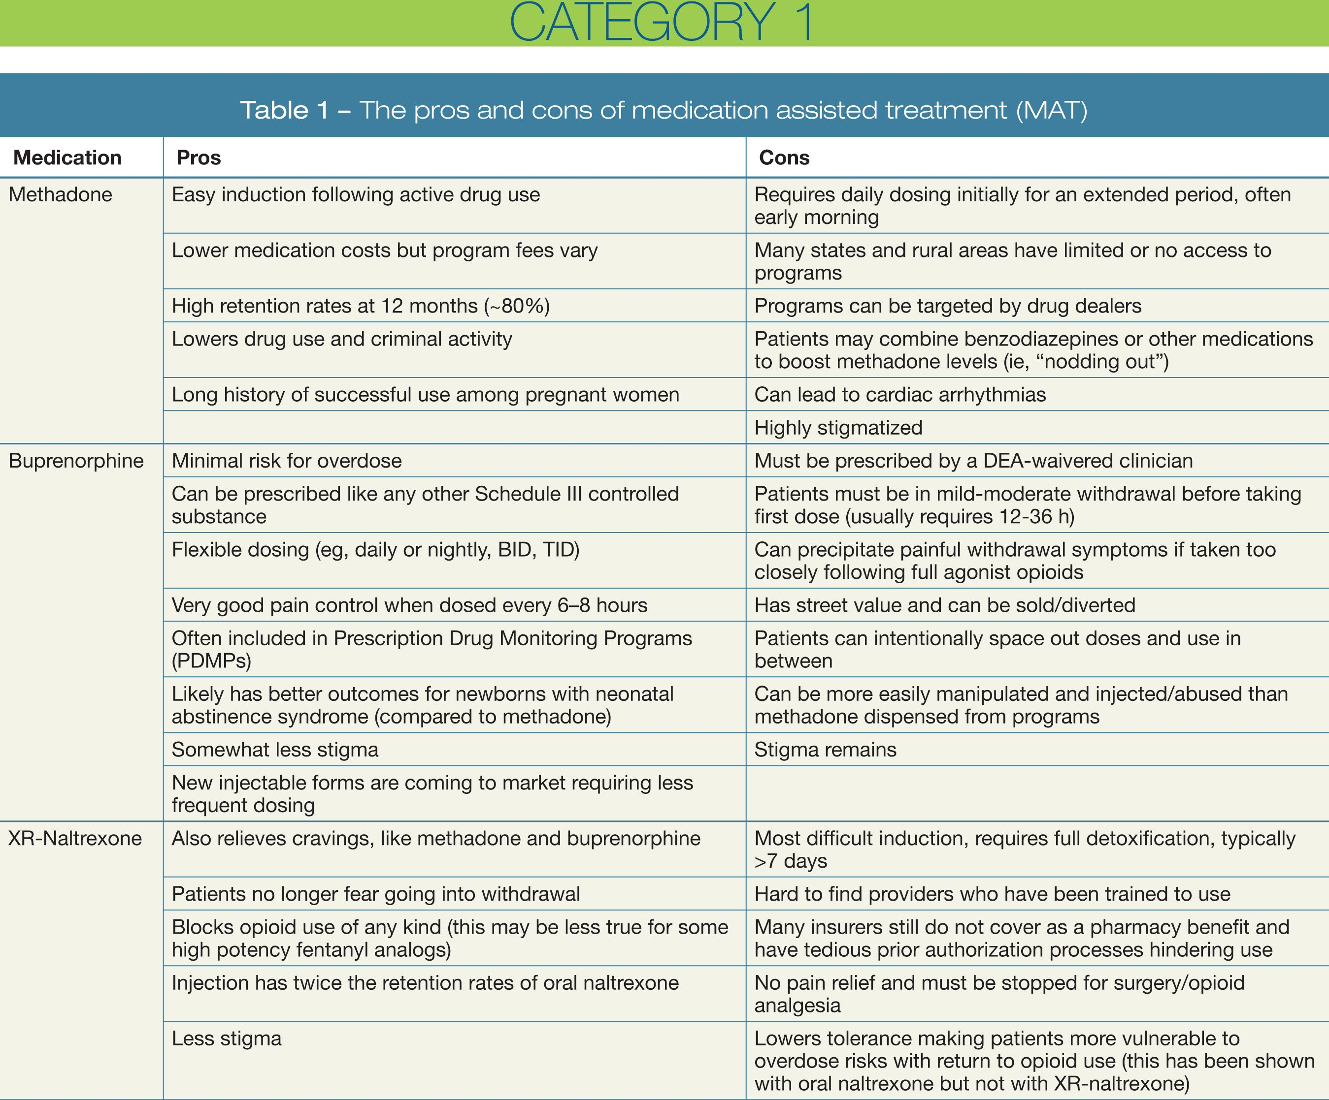
MAT Medications
https://www.psychiatrictimes.com/cme/responding-opioid-epidemic-and-expanding-access-quality-treatment/page/0/3
Notes:
Differences between Naloxone, Naltrexone and Vivitrol:
Naltrexone, a short acting opiate/alcohol blocking agent has been used for the last 30 years. Vivitrol is an extended release form of Naltrexone. The extended release properties of Vivitrol helps patient compliance as it does not have to be used every day.

Slide 27
Naltrexone
XR – long half-life
Administered IM monthly
Need to have a period of abstinence prior to giving
  Effective
  Can be prescribed in an office setting
  Possible side effects
  Very good safety profile
Notes:
Common Side Effects of Naltrexone (used for oUD and alcoholism)
You should tell your doctor if any of the following side effects become severe or don't go away:
Nausea, vomiting, diarrhea, or constipation
Stomach pain or cramping
Loss of appetite
Headache
Dizziness
Nervousness, irritability, or anxiety
Tearfulness
Increased or decreased energy
Difficulty falling asleep or staying asleep
Drowsiness
Rash
Muscle or joint pain
Mild discomfort at injection site (injectable form)
Serious Side Effects of Naltrexone
You should call your doctor immediately if you experience any of the symptoms listed in the warning section or any of the following serious side effects:
Signs of an allergic reaction (rash; hives; itching; breathing difficulties; chest tightness; or swelling of the mouth, face, lips, or tongue)
Hallucinations
Confusion
Blurred vision or eye problems
Cough, wheezing, or breathing troubles
Severe vomiting or diarrhea

Slide 28
Naloxone (Narcan)
Naloxone is a short-acting opioid antagonist
Used to reverse an opioid overdose
Highly effective, but may need repeat doses and/or higher doses in some case

Slide 29
Adjunctive treatment
Benefits of MAT
Helping to sustain long-term recovery Decreasing/preventing withdrawal symptoms Reducing the risk of relapse Improving quality of life Eliminating need for hospitalization Helping patients handle anger, anxiety, and substance abuse Reducing criminal activity | Decreasing cravings for opioids or alcohol Reducing illicit drug use Reducing the likelihood of overdosing Increasing retention in treatment Helping those who resist medications Reducing the risk of transmitting infectious diseases via injections, such as hepatitis C and HIV

Slide 30
Adjunctive treatment
Adjunctive treatment
Formal substance use disorder treatment
  Outpatient, Intensive Outpatient, Partial Hospitalization, Residential, Inpatient
Individual psychotherapy
  CBT, Trauma therapy, DBT, RET
Mutual help groups
  12-step meetings, Smart Recovery, Faith-based
Peer support
On-line resources

Slide 31
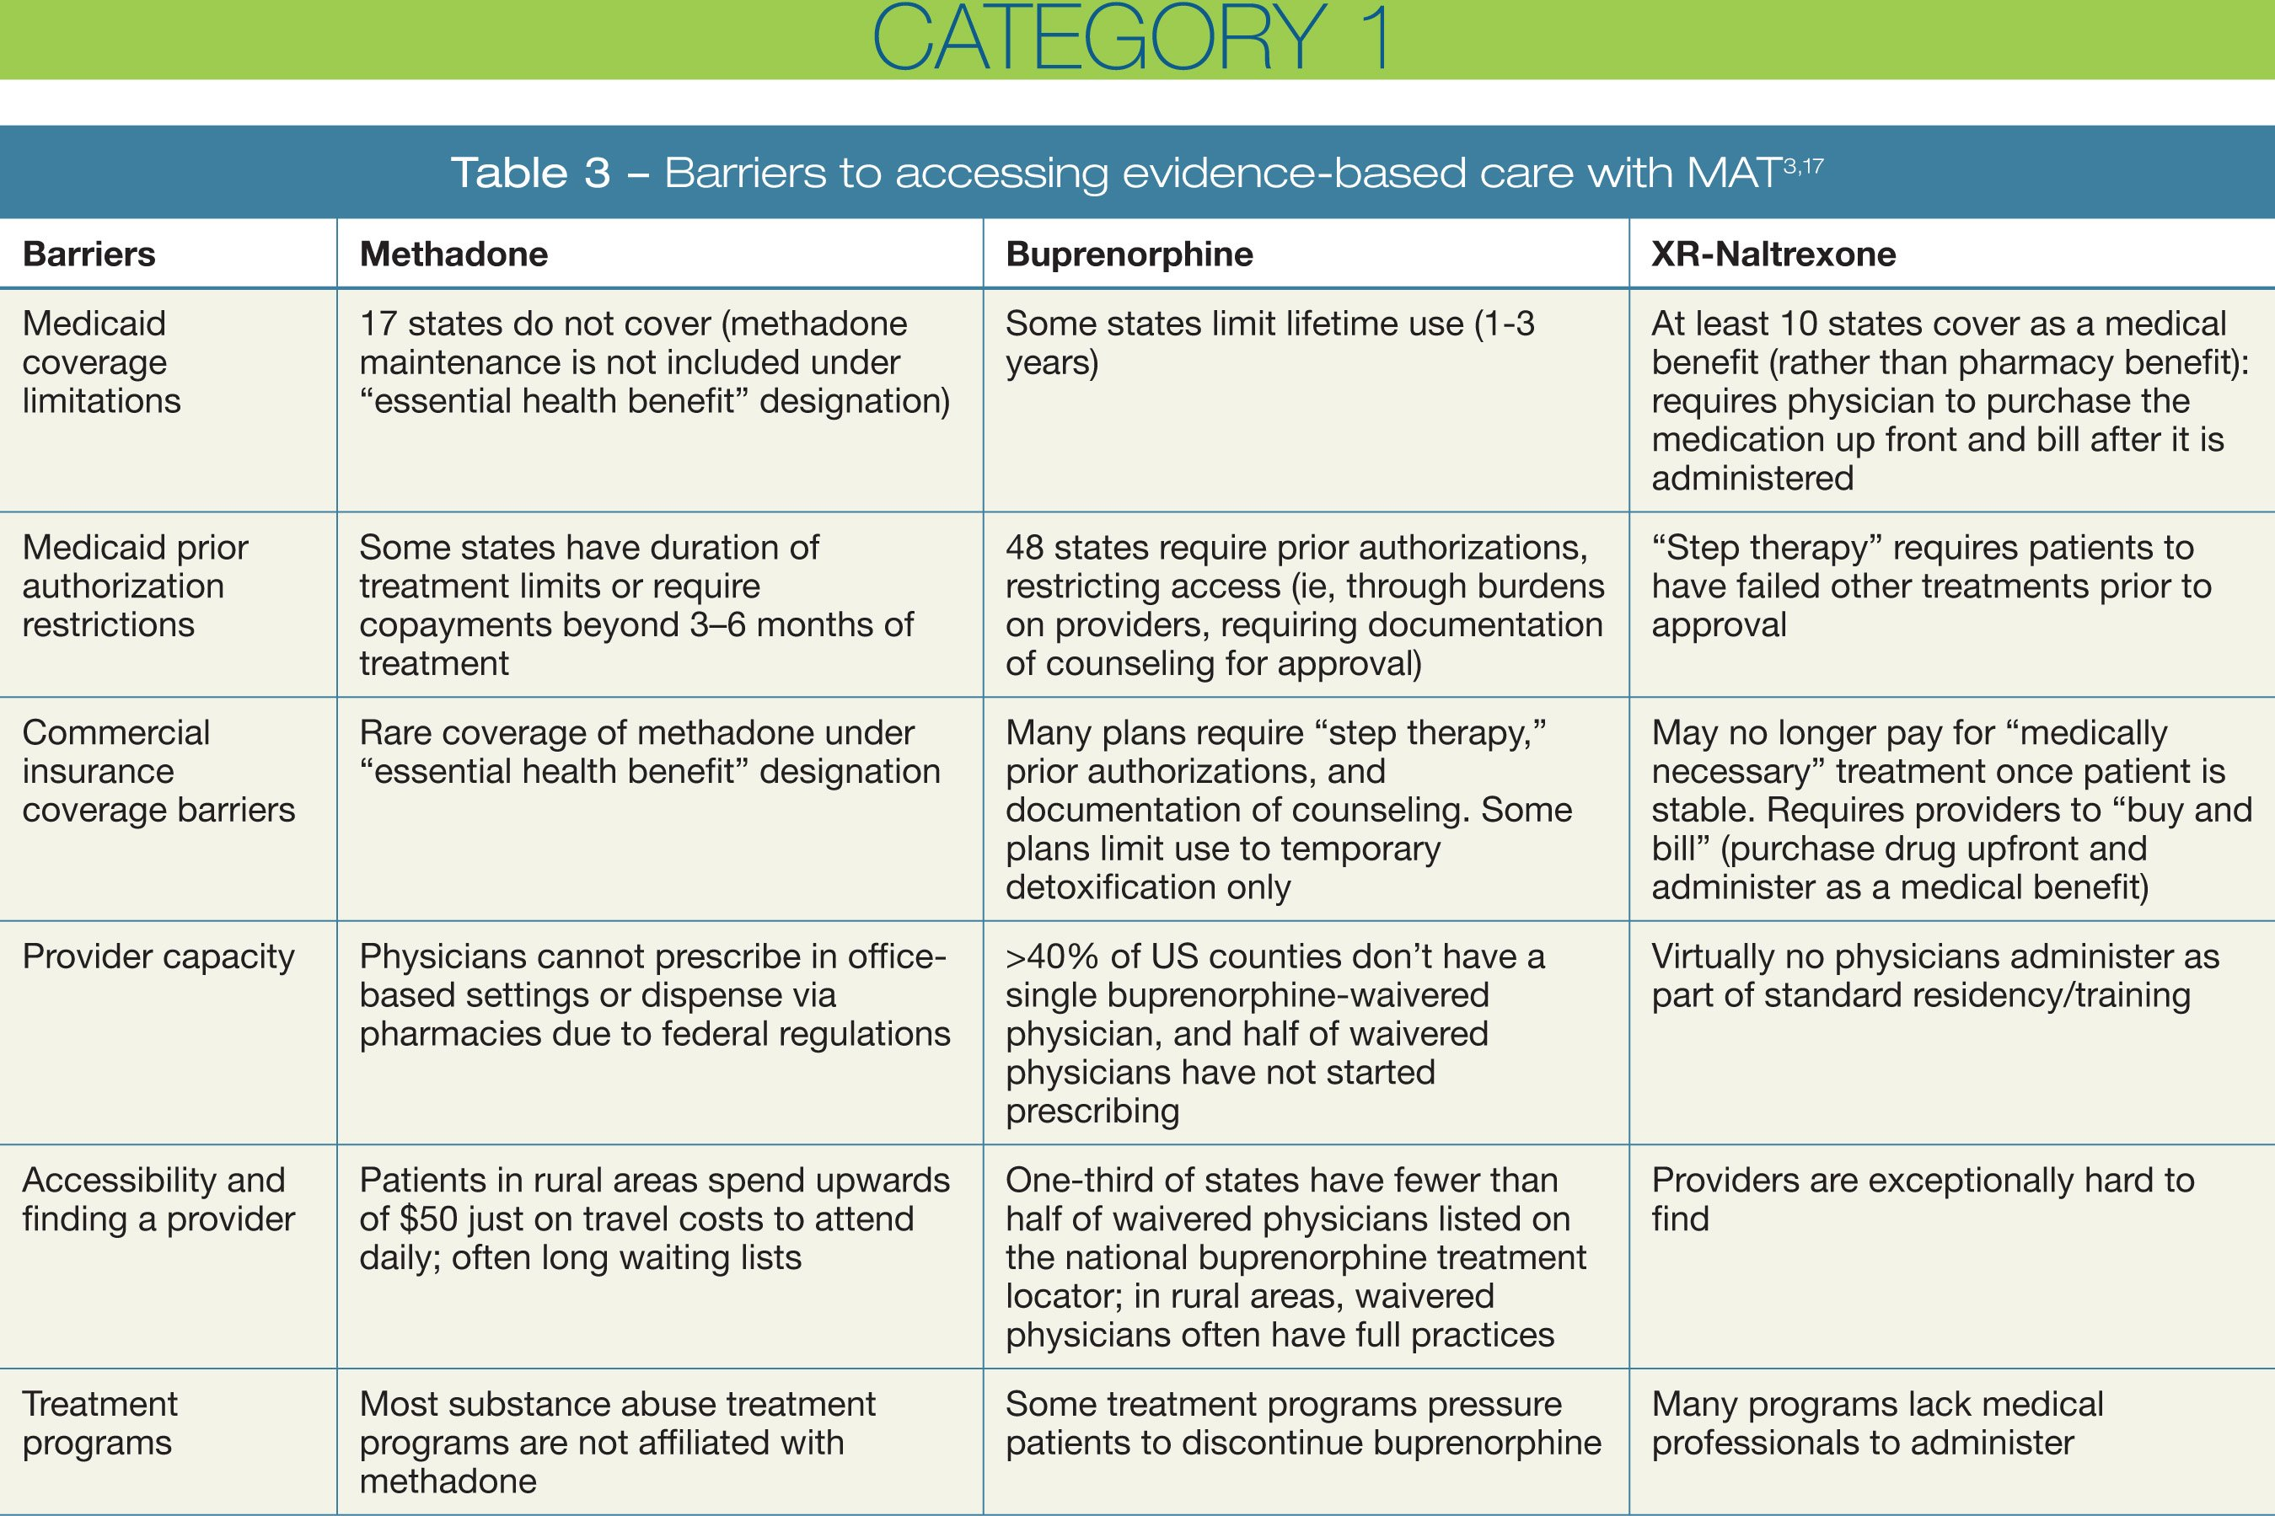
Adjunctive treatment
Barriers to Access
https://www.psychiatrictimes.com/cme/responding-opioid-epidemic-and-expanding-access-quality-treatment/page/0/3

Slide 32
Objections to Medication-Assisted Recovery
Still using an opioid / not clean
Crutch
They’re still addicted / dependent
They’re not in recovery
They’re treading water; not going any where/not moving forward
It’s just social control
Liquid handcuffs

Slide 33
How to Change Perception on MAT
Assess yourself – attitudes, beliefs and practices
Stay focused on non-stigmatizing language
Educate yourself
Be an educator
Embrace all pathways to recovery
Challenge institutions
Model successful MAT clients wherever possible

Slide 34
Evidence-Based Strategies
Enhance utilization for treatment while ensuring CHOICE
Continue education around MAT
Address barriers
Support telehealth for rural communities
Offer trainings
Reduce stigma through comprehensive messaging
Increase awareness of all pathways

Slide 35
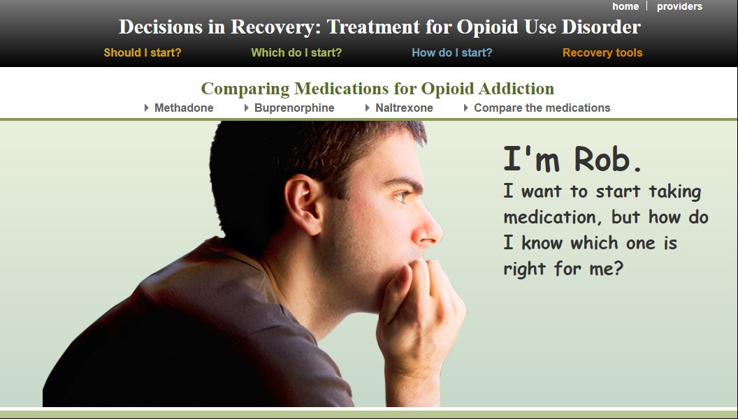
Decisions In Recovery
https://mat-decisions-in-recovery.samhsa.gov/section/which.aspx

Slide 36

What About Everything Else?
Is the next drug crisis a stimulant epidemic?
America's Next Drug Crisis? As opioids continue to plague rural areas, North Dakota’s health providers look for alternatives to a class of drugs called benzodiazepines, which also can be habit-forming and life-threatening.
Q&A: 'We're entering the fourth wave, which is methamphetamine’
Is Xanax Fuel for the Next Drug Crisis?

Slide 37
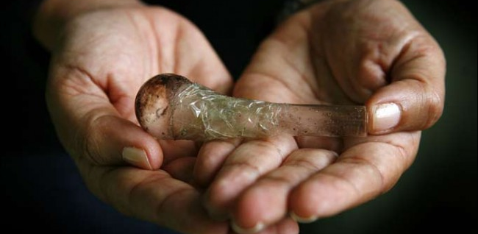
Cranking Into The Next Wave in Rural America
Although medications have proven effective in treating some substance use disorders, there are currently no medications that counteract the specific effects of methamphetamine or that prolong abstinence from and reduce the misuse of methamphetamine by an individual addicted to the drug.
The most effective treatments for methamphetamine addiction at this point are behavioral therapies, such as cognitive-behavioral and contingency management interventions.

Slide 38

Adjunctive treatment
Questions

Slide 39
References
Balasanova, A., “Addiction Par 1: Understanding the SUD continuum” and “Addiction Part 2: Focus on Opioid Use Disorder”, Opioid Response Network; STR-TA Presentation, 4/5/19
Tranen, B., “An Overview of Medication Assisted Treatment and Stigma”, Opioid Response Network; STR-TA Presentation, 5/31/19
Buffaloe, L., Campbell, J., Sethi, R., “Buprenorphine in Primary Care”, Opioid Response Network; STR-TA Presentation, 4/30/19
Kakko J, Svanborg KD, Kreek MJ, Heilig M. 1-year retention and social function after buprenorphine-assisted relapse prevention treatment for heroin dependence in Sweden: a randomized, placebo-controlled trial. Lancet 2003 Feb 22; 361 (9358); 662-8
Alaska DHSS website - http://dhss.alaska.gov/dph/Director/Pages/heroin-opioids/default.aspx

Slide 40
Contact the Opioid Response Network
To ask questions or submit a technical assistance request:
    Visit www.OpioidResponseNetwork.org
    Email orn@aaap.org
    Call 401-270-5900

Slide 41
Presenter Contact
Steven K. Samra, MPA
ssamra@C4innovates.com

