Slide 1
Neurobiology of Addiction
Wanhong Zheng MD
October 8, 2019

Slide 2
Working with communities to address the opioid crisis.
SAMHSA’s State Targeted Response Technical Assistance (STR-TA) grant created the Opioid Response Network to assist STR grantees, individuals and other organizations by providing the resources and technical assistance they need locally to address the opioid crisis .
Technical assistance is available to support the evidence-based prevention, treatment, and recovery of opioid use disorders.
Funding for this initiative was made possible (in part) by grant no. 6H79TI080816 from SAMHSA. The views expressed in written conference materials or publications and by speakers and moderators do not necessarily reflect the official policies of the Department of Health and Human Services; nor does mention of trade names, commercial practices, or organizations imply endorsement by the U.S. Government.

Slide 3
Working with communities to address the opioid crisis.
The Opioid Response Network (ORN) provides local, experienced consultants in prevention, treatment and recovery to communities and organizations to help address this opioid crisis.
The ORN accepts requests for education and training.
Each state/territory has a designated team, led by a regional Technology Transfer Specialist (TTS), who is an expert in implementing evidence-based practices.

Slide 4
Learning Objectives
Understand the neurobiological underpinnings of the chronic disease model of substance use disorder
Describe basic neuro circuits involved in substance use disorder
Understand the rationale of combined medical and cognitive/behavioral treatment for substance use disorder

Slide 5
Definition of disease
: a condition of the living animal or plant body or of one of its parts that impairs normal functioning and is typically manifested by distinguishing signs and symptoms : sickness

Slide 6
Addiction Definition - ASAM
“Addiction is a primary, chronic disease of brain reward, motivation, memory, and related circuitry. Dysfunction in these circuits leads to characteristic biological, psychological, social, and spiritual manifestations. This is reflected in an individual pathologically pursuing reward and/or relief by substance use and other behaviors.”

Slide 7
Recent Cases
34 years old female, currently 12-week pregnant. Smoking cocaine 8-ball a day. She has lost custody of her 5 children and now is homeless.
30-year-old male came to ED for detoxification from heroin and methamphetamine. He started using drugs at age 9. Reportedly he has overdosed more than 10 times.
45 years old female referred from PHP. Worked as a physician but lost her license due to drug misuse.
36-year-old female on long term antibiotics after 3rd cardiac valve repair.

Slide 8
Question #1: What is the closest connection two people can have?
Question #2: What other disease leads people to choose to continue to use something over having their children?
Question #3: Who in their “right mind” would ever choose a substance over their child?

Slide 9
“Just get out of my room!”

Slide 10
Drug addiction constitutes a chronic central nervous system disorder, characterized by recurrent episodes of relapse in which individuals resume drug-seeking behavior, even in the face of adverse consequences and diminishing reward.

Slide 11
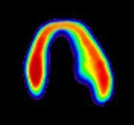
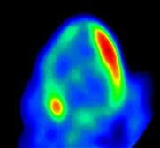
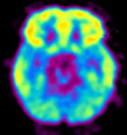
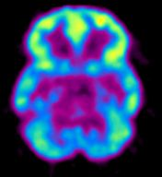
Substance use disorder changes brain structure and function
Decreased Heart Metabolism in Coronary Artery Disease
Decreased Brain Metabolism in Substance Use Disorder
High
Low
Healthy Heart
Healthy Brain
Diseased Heart
NIDA Website: Drug Abuse and Addiction: One of America's Most Challenging Public Health Problems.
Original sources: From the Laboratories of Drs. N. Volkow and H. Schubert
Notes:
NIDA Website: Drug Abuse and Addiction: One of America's Most Challenging Public Health Problems. Retrieved from https://archives.drugabuse.gov/publications/drug-abuse-addiction-one-americas-most-challenging-public-health-problems/addiction-chronic-disease

Slide 12
Reduced gray matter
MRI: Methamphetamine reduces gray matter
The yellow and red area in the central brain view indicates reduced gray matter density in the right middle frontal cortex. The same deficit is shown from other perspectives in the flanking views.
Kim SJ, et al. Prefrontal grey-matter changes in short-term and long-term abstinent methamphetamine abusers. International Journal of Neuropsychopharmacology. 2005;9(2):221–228.

Slide 13
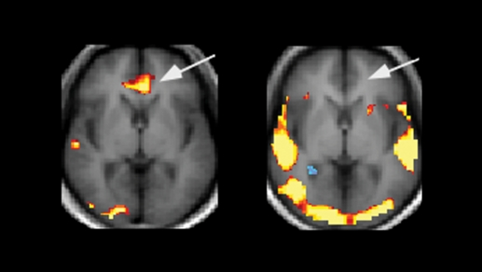
Cocaine User
Healthy Volunteer
Functional MRI: The brain’s response to cocaine cues
Arrows point to the anterior cingulate area, which is activated (yellow) in cocaine-addicted patients (left) but not in healthy volunteers (right).
Wexler BE, et al. Functional magnetic resonance imaging of cocaine craving. American Journal of Psychiatry. 2001;158(1):86–95.
Notes:
Wexler (2001) documented activation of the anterior cingulate cortex, a region associated with emotional processing, while cocaine-addicted subjects watched videotapes containing cocaine-associated cues, even if they did not experience craving. The finding indicates that addicted individuals’ emotional responses to cues have a subconscious component. The subjects also showed less activation in the frontal lobe than healthy subjects during the cocaine cue tapes, suggesting that their ability to control their cue responses was inhibited. Research with functional MRI has linked chronic stimulant abusers’ cognitive impairments to drug-related alterations in brain activation. In one study, methamphetamine dependence and poor decision making correlated with reduced activation in the PFC. In another, investigators discovered that chronic cocaine abusers had abnormally low levels of activity in midline areas of the anterior cingulate that are crucial for cognitive and behavioral control.

Slide 14
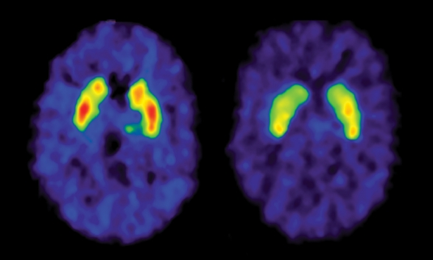
Healthy Control
Cocaine Abuser
PET: Cocaine markedly reduces dopamine D2 receptor availability
The striatum of the healthy control (left) is largely red, indicating the highest level of receptor availability, while that of the cocaine abuser has little red.
Volkow ND, et al. Decreased dopamine D2 receptor availability is associated with reduced frontal metabolism in cocaine abusers. Synapse. 1993;14(2):169–177.
Notes:
Dopamine Receptor Levels May Determine Vulnerability to Abuse and Addiction
PET studies have demonstrated that abusers of alcohol, cocaine, heroin, and methamphetamine all have reduced levels of brain dopamine receptors—the proteins on cell surfaces that dopamine activates to stimulate cellular activity. These findings, together with other evidence, have given rise to a hypothesis that people with low levels of these receptors, either genetically or as a result of their experiences, have a higher risk of drug abuse and addiction. Scientists speculate that such individuals obtain less than normal amounts of dopamine-mediated pleasure from ordinary activities and accomplishments and therefore are highly susceptible to wanting to repeat the euphoria that occurs when drugs massively increase dopamine in the brain.

Slide 15
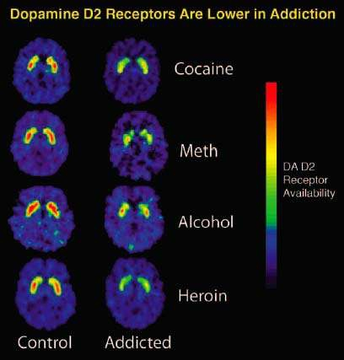
Biological
Header
https://archives.drugabuse.gov/news-events/nida-notes/2007/10/nidas-newest-division-mines-clinical-applications-basic-research

Slide 16
So Drugs and Alcohol can cause brain changes
After vs. Before

Slide 17
“Doc, I wish you could think like an addict at this moment! You have no idea how I feel.”

Slide 18
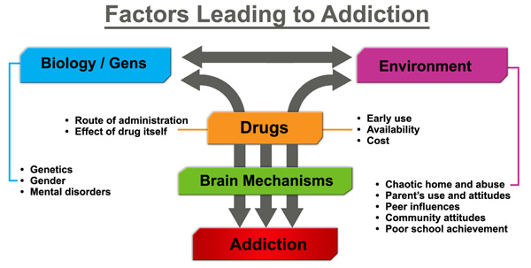
https://medicalschooledu.blogspot.com/2017/06/risk-factors-addiction.html
Notes:
Environmental factors: Structural, Proximal, Distal, Stress
Sociocultural factors, developmental factors…
Specific adolescent behaviors such as risk taking, novelty seeking, high sensitivity to peer pressure increase the propensity of experimenting with legal and illegal drugs, which might reflect incomplete development of brain regions (e.g. myelination of frontal lobe regions) involved in executive control and motivation processes.

Slide 19
Not everyone who takes a drug once gets addicted to it. Why?
Some drugs are intrinsically more addicting than others
Some individuals may be more genetically vulnerable
More impulsive by nature?
Have a genetically dysfunctional reward system?

Slide 20
Probability of becoming dependent when people have tried a substance at least once
Substance | Percentage
Tobacco | 32%
Heroin | 23%
Cocaine | 17%
Alcohol | 15%
Stimulants | 11%
Anxiolytics | 9%
Cannabis | 9%
Analgesic | 8%
Inhalants | 4%

Slide 21
Cumulative probability of transition from use to dependence (Catalina Lopez-Quintero, et al.)
Substance | After 10 years | Lifetime
Nicotine | 15.6% | 67.5%
Cocaine | 14.8% | 20.9%
Alcohol | 11.0% | 22.7%
Cannabis | 5.9% | 8.9%

Slide 22
Addiction is a chronic disease similar to other chronic diseases such as type II diabetes, cancer, and cardiovascular disease
Genetics
Environment
Life style choices

Slide 23
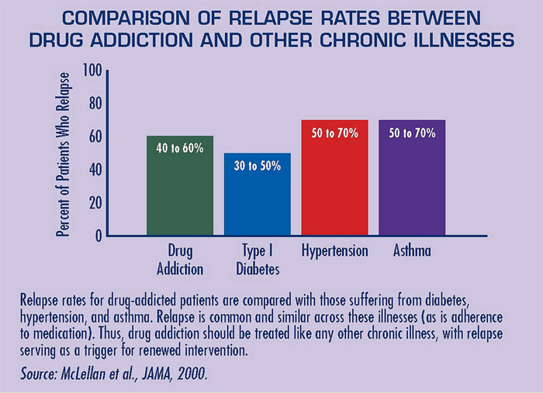

Slide 24
Biological
Original slide from: Neurobiology of OUD and Medications for OUD: Implications for Co-occurring Disorders
BRSS TACS Living Proof Series
Steven Samra, David Marcovitz, Ayanda Jordan

Slide 25
Genetics in Addiction
Inheritability has been found to range from 40-60%
4-fold increased risk in 1st degree relatives
4-fold increased risk also in adopted away children

Slide 26
Genetics in Addiction: Pedigree
Monozygotic twins have higher concordance of addiction than dizygotic twins
The more genes you share, the more similar your addiction propensity
Men whose parents were alcoholics have an increased likelihood of alcoholism even when adopted and raised by non-alcoholic parents from birth.

Slide 27
Genetics in Addiction: The Genome
In humans, several chromosomal regions have been linked to SUD, but only a few specific genes have been identified with polymorphism that either predispose to or protect from drug addiction.
Notes:
Some of these are polymorphism that interfere with drug metabolism. For example, specific alleles for the genes encode alcohol dehydrogenase ADH1B and acetaldehyde dehydrogenase ALDH 2 (Enzymes involved in metabolism of alcohol) are reported protective against alcoholism. A single nucleotide polymorphism in the gene encoding fatty acid amide hydrolase has been associated with increased recreational and problem use of drugs and alcohol.
Single nucleotide polymorphisms in the genes encoding the mu-opioid receptor correlates with an increased likelihood of heroin abuse.

Slide 28
No one chooses drug addiction or to develop heart disease.

Slide 29
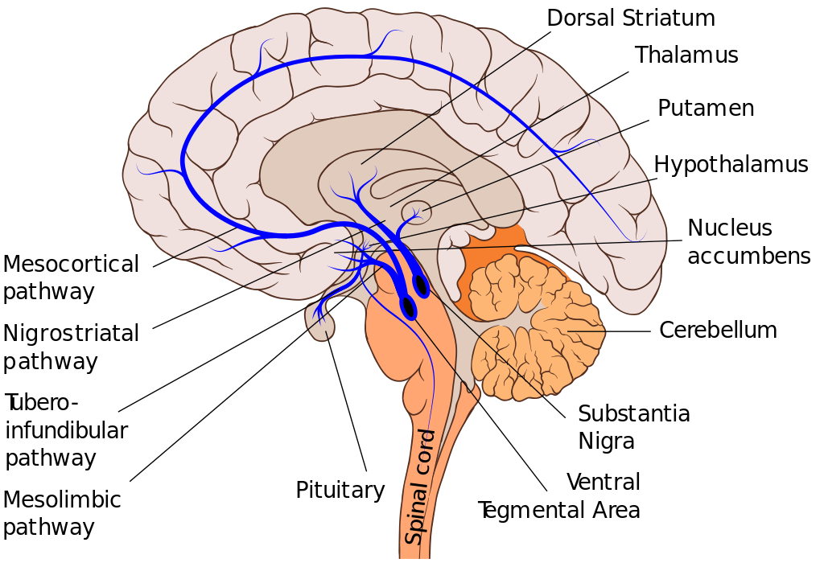
Dopamine
Reward/salience
Pleasure/euphoria
Motor function
Compulsion
Notes:
Dopamine is a chemical that is made by the human body and found in the brain. It is the chemical responsible for making us feel happy, as it is directly connected to our feelings of pleasure and being rewarded. Dopamine is what allows us to recognize a reward and motivates us to do whatever possible to attain that reward.
Low dopamine levels in people can result in certain health conditions, like depression or Parkinson's disease. People who suffer from lower dopamine levels also may be more susceptible to forming some addiction. One dopamine receptor, in particular, is linked to the "risk-taking" side of some people's personalities.

Slide 30
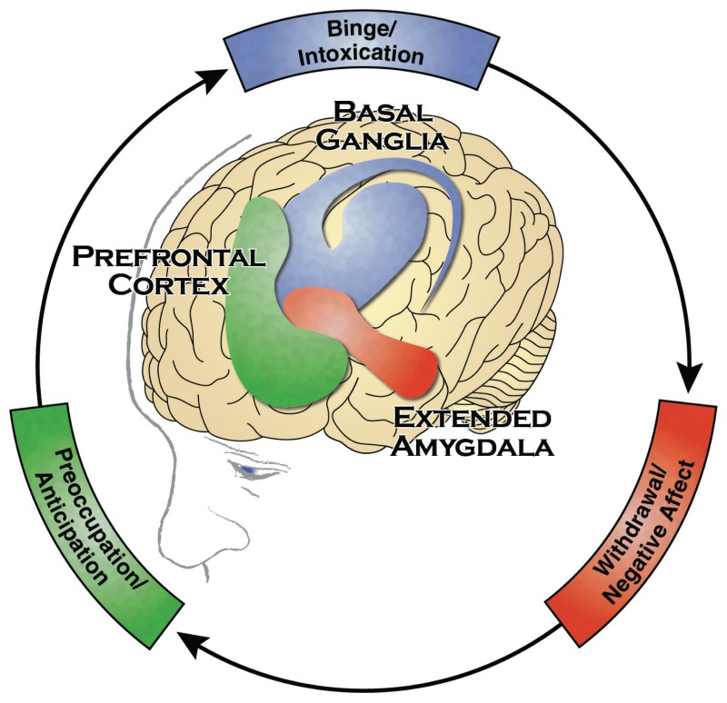
The Brain Regions Associated with Addiction
Facing Addiction in America: The Surgeon General's Report on Alcohol, Drugs, and Health [Internet]. Washington (DC): US Department of Health and Human Services; 2016 Nov.
Notes:
The Three Stages of the Addiction Cycle and the Brain Regions Associated with Them.
Binge/Intoxication, the stage at which an individual consumes an intoxicating substance and experiences its rewarding or pleasurable effects;
Withdrawal/Negative Affect, the stage at which an individual experiences a negative emotional state in the absence of the substance; and
Preoccupation/Anticipation, the stage at which one seeks substances again after a period of abstinence.
The brain has many regions that are interconnected with one another, forming dynamic networks that are responsible for specific functions, such as attention, self-regulation, perception, language, reward, emotion, and movement, along with many other functions.
Three regions are the key components of networks that are intimately involved in the development and persistence of substance use disorders:
the basal ganglia - control the rewarding, or pleasurable, effects of substance use and are also responsible for the formation of habitual substance taking.
the extended amygdala - involved in stress and the feelings of unease, anxiety, and irritability that typically accompany substance withdrawal.
the prefrontal cortex - involved in executive function (i.e., the ability to organize thoughts and activities, prioritize tasks, manage time, and make decisions), including exerting control over substance taking.

Slide 31
Revisiting the ASAM Definition of Addiction
“Addiction is a primary, chronic disease of brain reward, motivation, memory, and related circuitry.”

Slide 32
“My cousin overdosed. We tried to Narcan her back. It didn’t work. I used a line!”

Slide 33
Rats prefer auto-administration of electrical stimuli, which affect the dopamine reward circuit, over eating of a (normally) appetizing piece of cheese (drawing by Romain Giraud, student of SVI632 in 2010, University of Bordeaux).
Notes:
We eat in order to provide ourselves with the necessary elements that allow our body to function. Without eating, our body won’t last long. Therefore eating or drinking have evolutionary purpose. In order to engage and maintain feeding we have to feel good about it. This is normally linked to a reward system; such behaviors generate “feel good” or “pleasure” sensations so we will continue to feed ourselves.
Dopamine is thought to play an important role in this.
The importance of this reward pathway is best illustrated in experiments (by Dr. James Olds) where rats had electrodes implanted in their brain, at different anatomical locations, and could self-administer electrical stimulation by pressing a lever. In the experimental environment, the rats were given choices of only food supply or electrical stimulation (you either eat or you stimulate electrically). Repeated self-stimulation was observed with electrodes that reached nucleus accumbens, the “brain pleasure area”.
Importantly, self-stimulation of the rewarding pathway was shown to generate a powerful grip on feeding behavior as 16 out of 19 rats preferred to go without food or drink, even after days, in order to maintain contact with the lever. In other words, food can bring important pleasure but this sensation can be replaced by electrical stimulation of NA of the brain.

Slide 34
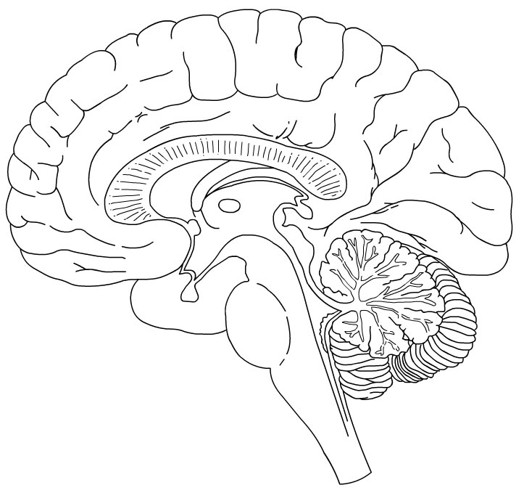
Amygdala &
Hippocampus
(A&H)
Prefrontal
Cortex (PFC)
Ventral Tegmental
Area (VTA)
Nucleus
Accumbens (NA)
Notes:
Three regions of reward networks that are involved in the development and persistence of substance use disorders can be further simplified into an addiction reward pathway which contains 4 nodes, and bidirectional connections among them.

Slide 35
Two complementary parts:
Reactive (bottom up)
Reflective (top down)
Notes:
A good way to conceptualize the reward system is to consider it as made up of two complementary parts: one that is reactive and one that is reflective. The reactive is a bottom up system because the signals start from lower lever then travel up. The reflective is top down, consists of neural projections from high level control center, frontal cortex to NA and A/H.

Slide 36
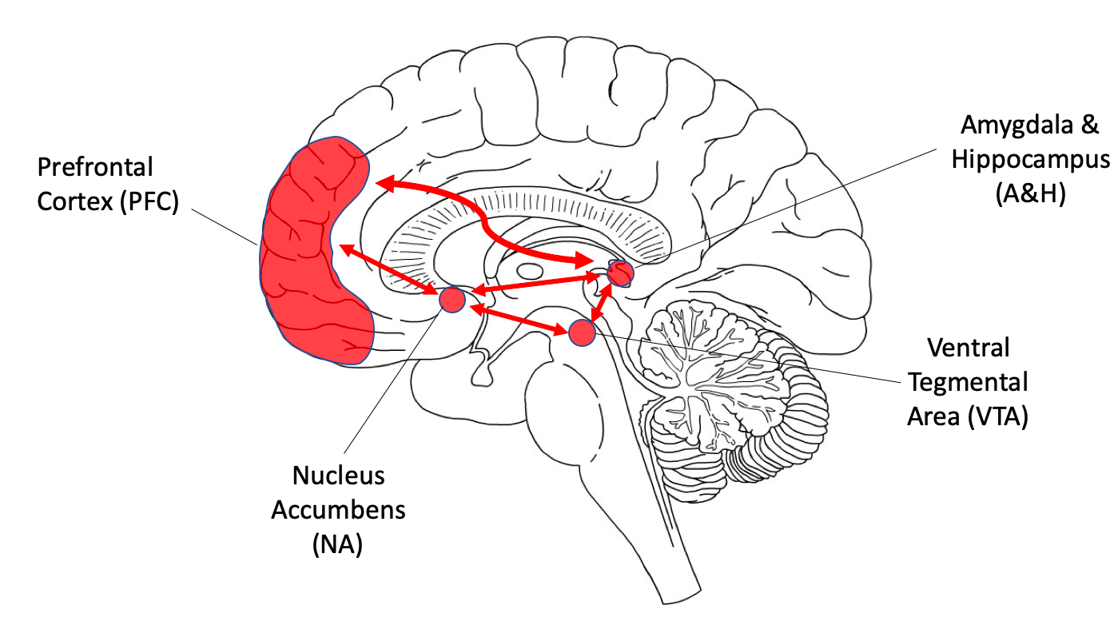

Slide 37
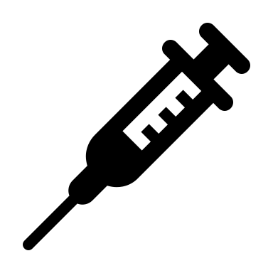
The Reactive Reward System
Learning
Wow
A & H
DA release
NA
VTA
Stimulated by source of pleasure (food, sex, drugs, cravings, cues)
Notes:
The reactive system has three nodes: VTA, NA, and A/H. It signals the immediate prospect of pleasure, using drugs or alcohol, provides motivation and behavioral drive to achieve that pleasure, way more intense than food or sex. The DA neurons start from VTA which is the site of cell bodies, project to NA where the DA neurotransmitters are released, also to A/H. the burst of DA in NA is very much related to the reward of pleasure ”feelings”, and connections to A/H are involved in learning. In other words, each time there is a pleasant feeling, Amygdala senses it, Hippocampus consolidates it, and tells the brain to keep it in storage. Moreover, the backward connection from A/H to VTA communicate whether anything relevant to a previously experienced pleasure (remember it has been learned and stored) has been detected. Finally, connections from Amygdala to NA and other brain structures communicate that emotions have been triggered by internal or external cues and signal an impulsive response to be taken.

Slide 38
“Doc, you don’t understand. I have been on Xanax for 17 years! It is the only thing that worked for my anxiety!”

Slide 39
Notes:
Stimulatory input from the “bottom up” reactive system is regulated by the “top down” reflective system, which consists of projections from the prefrontal cortex to the NA and A/H.

Slide 40
The Reflective Reward System
Final decision:
Integrating emotions/affect/analysis/impulses/cognitive flexibility
DLPFC
(Analysis)
VMPFC
(Emotions)
A & H
OFC
(Impulses)
NA
DA release
Notes:
This system involves 3 major areas of PFC: OFC, VMPFC, DLPFC. Also Insula is related to emotional decision making.
It is build and maintained over time
Based on various influences: neurodevelopment, genetics, peer pressure, the learning of social rules, the learning of benefits of suppressing current pressure for more valuable future gain.
Shape the final output of the reward system into long-term beneficial goal-directed behaviors.
When all the inputs are integrated, the final output is either to stop the action that the reactive system is triggering (drug seeking or using) or to let it happen.

Slide 41
Putting together

Slide 42
Disengaged Circuits
Alcohol
Amygdala &
Hippocampus
(A&H)
Prefrontal
Cortex (PFC)
Ventral Tegmental
Area (VTA)
Cocaine
Heroin
Nicotine
Amphetamine
Opioids
THC
Nucleus
Accumbens (NA)
Cocaine
Heroin
Notes:
Drugs affect the reward pathway and in chronic drug users, the two complementary systems are disengaged. The reflective system has lost control and cannot “vote” for long term beneficial goal directed decision. The picture shows roughly where the drugs and alcohol affect this pathway. Cocaine/heroin have direct impact on NA and alcohol, even though damages a different are or link of the pathway, the net effect is same: disconnect the reflective system from the bottom up reactive system, therefore hijack the PFC so the lower level reactive system can act on is own impulsively. Like a car without brake, runs until crashes.

Slide 43
Recruitment of Brain Stress System
Extra-hypothalamic
CRF
Notes:
AVP Arginine Vasopressin
PVN Paraventricular Nucleus of the hypothalamus
The progression from occasional, impulsive drug use to compulsive use and addiction involves both the dysregulation of reward circuits and the recruitment of brain/hormonal stress responses.
With initial use, the reward system is activated and the stress pathway gets involved to compensate for the reward: hormone levels change in response to stress/depressive or anxious feelings, guilt etc. With time going on, the reward system is still activated but the sensitivity changes, not the same level of pleasure can be reached, to compensate for this, the stress system gets overactivated, as manifested by more pronounced hormonal level change. In other words, the use will feel more and more depressed, anxious, frustrated, stressful or agitated.

Slide 44
From Stahl's Illustrated Substance Use and Impulsive Disorders 1st Edition
Notes:
Development of Tolerance and Acute Withdrawal: Neurotransmitter Changes
This shows the neurotransmitter changes associated with the dysregulation of reward circuits and the recruitment of the stress pathway. As these systems became dysregulated, tolerance develops such that the release of “rewarding” transmitters is reduced in response to drug exposure.
During acute withdrawal, there is a decrease in mesolimbic DA activity, reflected in part by a decrease in D2 receptors. There is also decreased activity of opioids, GABA, and glutamate in the NA and the amygdala. In addition, there is recruitment and activation of neurotransmitter systems involved in stress and anxiety, including activation of CRF in the extended amygdala, activation of Dynorphin, activation of NE, and reduced activity of NPY.
The positively reinforcing effects of substances tend to diminish with repeated use. Tolerance develops and lead to use of the substance in greater amounts and/or more frequently in an attempt to experience the initial level of reinforcement. Eventually, in the absence of the substance, a person may experience negative emotions such as stress, anxiety, or depression, or feel physically ill. This is what we call withdrawal, which often leads the person to use the substance again to relieve the withdrawal symptoms.
As use becomes an ingrained behavior, impulsivity shifts to compulsivity, and the primary drivers of repeated substance use shift from positive reinforcement (feeling pleasure) to negative reinforcement (feeling relief), as the person seeks to stop the negative feelings and physical illness that accompany withdrawal. Eventually, the person begins taking the substance not to get “high,” but rather to escape the “low” feelings to which, ironically, chronic drug use has contributed. Compulsive substance seeking is a key characteristic of addiction, as is the loss of control over use.

Slide 45
Understanding Neurobiology and Addiction Treatment
Notes:
Reward Pathways
Blocking agents (naltrexone), +/- opioid agonists like methadone and buprenorphine, disulfiram (Antabuse)
Treating underlying “reward system disruption” i.e., major depression
Stress Pathways
Decreasing withdrawal symptoms (i.e. opioid agonist treatment, GABA modulators in alcohol use disorder like benzodiazepines acutely and gabapentin/acamprosate/topiramate)
Treat underlying comorbid anxiety and other disorders
Executive Function Pathways
Treat comorbid ADHD, bipolar disorder, etc.
To re-build the reflective system – psychotherapy, peer-support groups, recovery coach, 12-step sponsorship, supportive system, jobs, relationships…
the learning of social rules, the learning of benefits of suppressing current pressure for more valuable future gain.
Shape the final output of the reward system into long-term beneficial goal-directed behaviors.

Slide 46
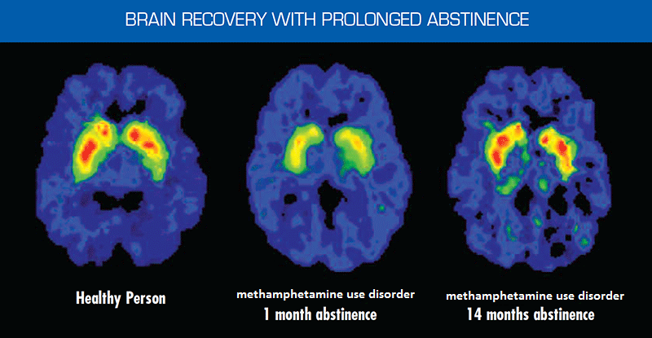
Volkow et al. J. Neurosci., December 1, 2001, 21(23):9414–9418
Notes:
There is a hope for healing: brain cells can rewire!
Subjects. Five METH abusers (three females, two males; 29 ± 3 years of age) were evaluated twice: during early and then protracted abstinence. PET scan follow up evaluation – 14 months into recovery, brain activity level approaches to normal control!

Slide 47
“I still have my kids.”
“I make way less money now but have more in my pocket! I am happy.”

Slide 48
References
Substance Abuse and Mental Health Services Administration (US); Office of the Surgeon General (US). Facing Addiction in America: The Surgeon General's Report on Alcohol, Drugs, and Health [Internet]. Washington (DC): US Department of Health and Human Services; 2016 Nov. https://www.ncbi.nlm.nih.gov/books/NBK424849/
Kim SJ, et al. Prefrontal grey-matter changes in short-term and long-term abstinent methamphetamine abusers. International Journal of Neuropsychopharmacology. 2005;9(2):221–228.
Wexler BE, et al. Functional magnetic resonance imaging of cocaine craving. American Journal of Psychiatry. 2001;158(1):86–95.
Bolla KI, et al. Orbitofrontal cortex dysfunction in abstinent cocaine abusers performing a decision-making task. Neuroimage. 2003;19(3):1085–1094.
Volkow ND, et al. Decreased dopamine D2 receptor availability is associated with reduced frontal metabolism in cocaine abusers. Synapse. 1993;14(2):169–177.
Nora D. Volkow et. al. Loss of Dopamine Transporters in Methamphetamine Abusers Recovers with Protracted Abstinence. Journal of Neuroscience 1 December 2001, 21 (23) 9414-9418; DOI: https://doi.org/10.1523/JNEUROSCI.21-23-09414.2001
Fowler JS, Volkow ND, Kassed CA, Chang L. Imaging the addicted human brain. Sci Pract Perspect. 2007;3(2):4–16.
Stephen M. Stahl, Meghan M. Grady, et al. Stahl's Illustrated Substance Use and Impulsive Disorders. Cambridge University Press. Nov 26, 2012 ISBN-13: 978-1107674530 ISBN-10: 1107674530

Slide 49
References (Cont’d)
Medical School Education. Risk Factors for Addiction | Addiction Risk Factor. https://medicalschooledu.blogspot.com/2017/06/risk-factors-addiction.html Last Accessed 09/25/2019
McLellan AT, Lewis DC, O’Brien CP, and Kleber HD. Drug dependence, a chronic medical illness: Implications for treatment, insurance, and outcomes evaluation. JAMA 284(13):1689-1695, 2000.
Catalina Lopez-Quintero, et al., "Probability and Predictors of Transition From First Use to Dependence on Nicotine, Alcohol, Cannabis, and Cocaione: Results of the National Epidemiologic Survey on Alcohol and Related Conditions (NESARC)," Drug and Alcohol Dependence, 2011 May 1; 115(1-2): 120-130. doi:10.1016/j.drugalcdep.2010.11.004

Slide 50
Contact the Opioid Response Network
To ask questions or submit a request for technical assistance:
Visit www.OpioidResponseNetwork.org
Email orn@aaap.org
Call 401-270-5900

